Slide 1
22 August 2017 SWBAT: Explain classroom policies and procedures.
Finding Common Ground
Get one for your group
Bellwork (20 minutes)
Agenda (5 minutes)
Skills (10 minutes)
Cornell Notes
Rules practice
Workshop (40 minutes)
Marketing discussion
Bellwork routine
Peace/Out (5 minutes)
Bellwork
Youngest person selects question to pose to the group.
30 seconds of thought.
EVERYONE in group answers.

Slide 2
22 August 2017 SWBAT: Explain classroom policies and procedures.
UPCOMING- EVEN DAY
THIS WEEK 8/22 Policies and Procedures 8/24 Still More Policies and Procedures “Manifesto” project begins | NEXT WEEK 8/28 Censorship letter Group Project 8/30 Finding Wisdom 9/1 “Manifesto” DUE Censorship permission DUE9/7 Censorship unit begins
Put this in your Agenda

Slide 3
Pam Homan Homan H English 1 22 August 2017
This is MLA heading
This is the space where you put your thoughts, notes, pictures…it is the connections place…
I am an introvert, which might make you think don’t like people, but I think my sense of humor and my willingness to listen are two of my best qualities, which serve me well in a classroom. There have been times when…
DATE
This is the space where you have your topic—the main idea
B

Slide 4
Pam Homan Homan H English 1 22 August 2017
This is MLA heading
Abolitionist leader Fredrick Douglas is noted as observing, “there are two types of people: those who come into the room and say ‘well here I am,’ and those who come in and say ‘Ah, there you are’” (Brainyquotes). As an introvert, I am definitely not going to try to draw attention to myself, but I do have a good sense of humor, and I am very willing to listen. These qualities serve me well in a classroom.
There have been times when…
DATE
B
What was the topic? (reflect the prompt)
Is there a claim? (thesis)
Do I help the reader try to connect with me? (example)

Slide 5
Pam Homan Homan H English 1 22 August 2017
This is MLA heading
Abolitionist leader Fredrick Douglas is noted as observing, “there are two types of people: those who come into the room and say ‘well here I am,’ and those who come in and say ‘Ah, there you are’” (Brainyquotes). As an introvert, I am definitely not going to try to draw attention to myself, but I do have a good sense of humor, and I am very willing to listen. These qualities serve me well in a classroom.
There have been times when…
DATE
B
What was the topic? (reflect the prompt)
Is there a claim? (thesis)
Do I help the reader try to connect with me? (example)

Slide 6
22 August 2017 SWBAT: Explain classroom policies and procedures.
Finding Common Ground
You will do this each class…
Write on a piece of scratch paper
MLA heading
What are six words that describe your day so far?
Bellwork (20 minutes)
Agenda (5 minutes)
Skills (10 minutes)
Cornell Notes
Rules practice
Workshop (40 minutes)
Marketing discussion
Bellwork routine
Peace/Out (5 minutes)
What type of sentence is that?

Slide 7
22 August 2017 SWBAT: Explain classroom policies and procedures.
Finding Common Ground
Bellwork (20 minutes)
Agenda (5 minutes)
Skills (10 minutes)
Cornell Notes
Rules practice
Workshop (40 minutes)
Marketing discussion
Bellwork routine
Peace/Out (5 minutes)

Slide 8
Homan Rules
A Lesson on Behavior—
Not Awesomeness
Notes:
As we begin our journey into the new school year, I want to introduce myself and let you know what you should be looking forward to this year. You’ve heard of the show “What Not to Wear”? I’ve put together a little presentation I like to think of as “What Not to Do” in my classes. I think it’s important for everyone to be on the same page as we start off the year together. I’ve set it up as a play on works of literature as we’re in an English class…there may be a quiz at the end, so pay attention.

Slide 9
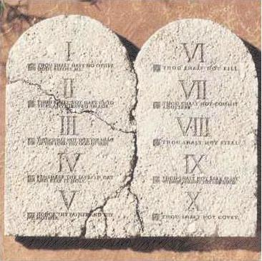
And the Teacher said…
Thou Shall Sit Where I Seat You
I move students quite often, and you do group work.
It’s OK.
Notes:
For the first week, until I’m sure I know who you are, I need you to sit where I place you. After the first week, depending on your ability to act like responsible students, I’ll let you sit where you like. It’s important that you understand that if I think you aren’t able to handle where you choose to sit, I’ll have you move where I see fit. It’s not a punishment, rather an opportunity for you to learn.

Slide 10
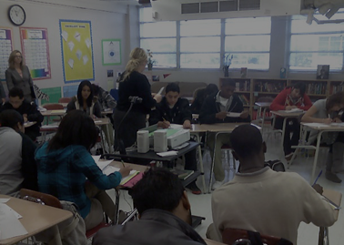
I’m OK…You’re OK
On Time
On Task
EVERY DAY
Notes:
In this classroom, as long as you follow some simple guidelines everything will be all right. Be on time. Be on task. Every day.
Other housekeeping notes: Restroom breaks? Not during class while I’m lecturing. Pencil sharpening? Not while I’m instructing. Hand raising—generally approved, if it gets too out of hand, I’ll let you know. Food? Probably not, though we’ll see as the year progresses. Cell phones? Not anymore. No electronics.

Slide 11
Pride and Prejudice
Notes:
I couldn’t figure out a picture to use for this. So I’ll just say this. Don’t have too much pride to ask for help. I am here early, I will stay late if you let me know ahead of time. I cannot think on any reason you should not be able to do your personal best. This class is not a competition for grades, there should be no prejudices held against one another. We’re all here to learn.
OF COURSE, the worst time you can ask about it is after the project is due.

Slide 12
Number 1 Rule
R-E-S-P-E-C-T
Notes:
In our classroom, the number one rule is respect. For yourself, for your peers, for me. I get that you might be having a bad day, but there’s not any reason to come and ruin everyone’s day. There’s a saying that respect needs to be earned—I get that, but assume as a member of this community you will do your best each day.

Slide 13
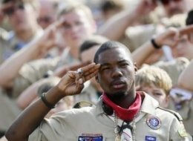
Be All That You Can Be
Be Prepared
Notes:
It’s all about expectations. Be prepared for class. Right now you are students, and your job at school is to learn. As adults, if you come to work without the necessary tools, you can’t do the job, and you get fired. I’m not your boss, but I can “fire you”. I do understand you have an outside life, that sometimes things get in the way, that you have pressures outside this room. If you need help, ask for it. Be prepared to be a student in this classroom.

Slide 14
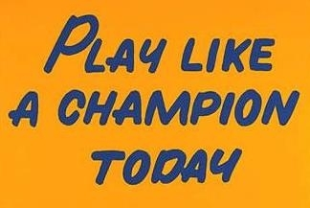
Great Expectations
Notes:
Expect to succeed. Notre Dame has this sign hanging in their locker room, the players touch it every single time they leave the locker room for the field. It serves as a simple reminder that they are representing their school, their family, themselves. In this classroom, in this school, you need to “play like a champion” each time you enter the room. I want you to think “Am I doing my job? Am I representing who I want to be? Am I someone to be proud of?”

Slide 15
Much Ado About Nothing
Notes:
You may find this presentation to be boring, stupid, or awesome. You may think the same about me. I can tell you this “expectations talk” is not much ado about nothing though. I am here every day, excited to do this job because I love learning, and I love figuring out fun ways to help kids learn. I want you to succeed in this class. I expect you to do well. I am prepared for you to meet all my expectations, and then some.

Slide 16
Number #1 Rule?
Slide 6
Notes:
Do you remember? Raise your hand to answer…

Slide 17
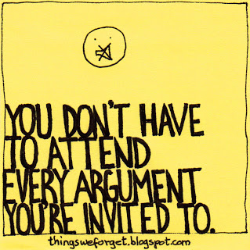
Random
Notes:
Do you remember? Raise your hand to answer…

Slide 18
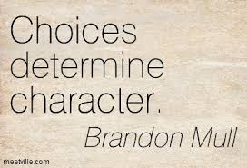
22 August 2017 SWBAT: Explain classroom policies and procedures.
Finding Common Ground
Bellwork Pick 1. At least 25 words. Complete sentences.
For what are you responsible?
What is one thing you wish you didn’t have as a responsibility? Why?
What does this quote mean?
VOCABULARY/CORNELL/your sentence
Justify (v.)
to prove or show to be just, right, or reasonable (to explain your reasoning)
You will be doing this every day.
Bellwork (20 minutes)
Agenda (5 minutes)
Skills (10 minutes)
Cornell Notes
Rules practice
Workshop (40 minutes)
Marketing discussion
Bellwork routine
Peace/Out (5 minutes)

Slide 19
22 August 2017 SWBAT: Explain classroom policies and procedures.
Finding Common Ground
You will do this each class…
Write on a piece of scratch paper
MLA HEADING
You do not need to now,
you already did it.
Bellwork (20 minutes)
Agenda (5 minutes)
Skills (10 minutes)
Cornell Notes
Rules practice
Workshop (40 minutes)
Marketing discussion
Bellwork routine
Peace/Out (5 minutes)

