Slide 1
28 August 2017 SWBAT: Use contextual skills to "find wisdom"; defend thesis using evidence
CHOICES & CONSEQUENCES
In third person.
Write on a piece of scratch paper
MLA HEADING/remember BLOCK
Use an exclamatory sentence to tell me one thing you did this weekend.
Bellwork (10 minutes)
Agenda (2 minutes)
Skills (20 minutes)
Editing manifesto
Workshop (45 minutes)
Finding Wisdom
Peace/Out (5 minutes)

Slide 2
28 August 2017 SWBAT: Use contextual skills to "find wisdom"; defend thesis using evidence
UPCOMING- EVEN DAY
THIS WEEK 8/28 Group Project 8/30 Censorship letter “Finding Wisdom” work 9/1 “Manifesto” DUE Permission DUE9/7 Censorship unit begins (read over weekend?) | NEXT WEEK NO SCHOOL ON MONDAY 9/6 Peer editing “Wisdom” 9/8 TBD based on pacing You have your book
Put this in your Agenda

Slide 3
28 August 2017 SWBAT: Use contextual skills to "find wisdom"; defend thesis using evidence
Literary device: homophone
-nym
-graph
Finding Common Ground
Need:
Very Special Marking Pen
Student work “Bulldog Manifesto”
Brain
Ears
Peer Editing
Bellwork (10 minutes)
Agenda (2 minutes)
Skills (20 minutes)
Editing manifesto
Workshop (45 minutes)
Finding Wisdom
Peace/Out (5 minutes)

Slide 4
28 August 2017 SWBAT: Use contextual skills to "find wisdom"; defend thesis using evidence
Finding Common Ground
Whatever is not present, write in
Peer Editing
Bellwork (10 minutes)
Agenda (2 minutes)
Skills (20 minutes)
Editing manifesto
Workshop (45 minutes)
Finding Wisdom
Peace/Out (5 minutes)
MLA heading
Title
(Bulldog Manifesto?)
(Student Manifesto?)
Categories
Reading
Writing
Relationship

Slide 5
28 August 2017 SWBAT: Use contextual skills to "find wisdom"; defend thesis using evidence
Finding Common Ground
Station Rotations
Bellwork (10 minutes)
Agenda (2 minutes)
Skills (20 minutes)
Editing manifesto
Workshop (45 minutes)
Finding Wisdom
Peace/Out (5 minutes)
1. “Manifesto” Read my “Model” Use same categories to create your own |  | 2. Supply Drive “poster” Check my model for information needed Working in teams, use my information to create your own (I do not need 20 copies)
X

Slide 6
28 August 2017 SWBAT: Use contextual skills to "find wisdom"; defend thesis using evidence
Finding Common Ground
Manifesto (n): a written statement that describes the policies, goals, and opinions of a person or group
Station Rotations
1.
“Manifesto”
Need:
Model, paper pen/pencil, brain
Bellwork (10 minutes)
Agenda (2 minutes)
Skills (20 minutes)
Editing manifesto
Workshop (45 minutes)
Finding Wisdom
Peace/Out (5 minutes)

Slide 7
28 August 2017 SWBAT: Use contextual skills to "find wisdom"; defend thesis using evidence
Finding Common Ground
Ex: “I have always been a strong writer, this year I will remain open to criticism and not take it personally”
Station Rotations
1.
“Manifesto”
Bellwork (10 minutes)
Agenda (2 minutes)
Skills (20 minutes)
Editing manifesto
Workshop (45 minutes)
Finding Wisdom
Peace/Out (5 minutes)
Annotate Document name Categories | Determine What was author doing? What was her tone? | Create Your own “manifesto”

Slide 8
28 August 2017 SWBAT: Use contextual skills to "find wisdom"; defend thesis using evidence
Finding Common Ground
Writing
I have always been a strong writer, this year I will remain open to criticism and not take it personally
I will try to write in new genres.
Reading
I will not decide something is too hard and just give up, I’ll accept that this might be part of the struggle of learning.
Station Rotations
1.
“Manifesto”
Bellwork (10 minutes)
Agenda (2 minutes)
Skills (20 minutes)
Editing manifesto
Workshop (45 minutes)
Finding Wisdom
Peace/Out (5 minutes)
Examples of what you could say.

Slide 9
28 August 2017 SWBAT: Use contextual skills to "find wisdom"; defend thesis using evidence
Finding Common Ground
Skill:
Imbedding a quote
As a teacher, it is difficult to find time to just sit and write for myself. However, as author Doris Lessing once observed, “You only learn to be a better writer by actually writing” (Interview NYTimes). This year I will try to make time to write more-- I need to consider reactivating my blog since I like writing for an audience.
Station Rotations
1.
“Manifesto”
Bellwork (10 minutes)
Agenda (2 minutes)
Skills (20 minutes)
Editing manifesto
Workshop (45 minutes)
Finding Wisdom
Peace/Out (5 minutes)
This was original claim

Slide 10
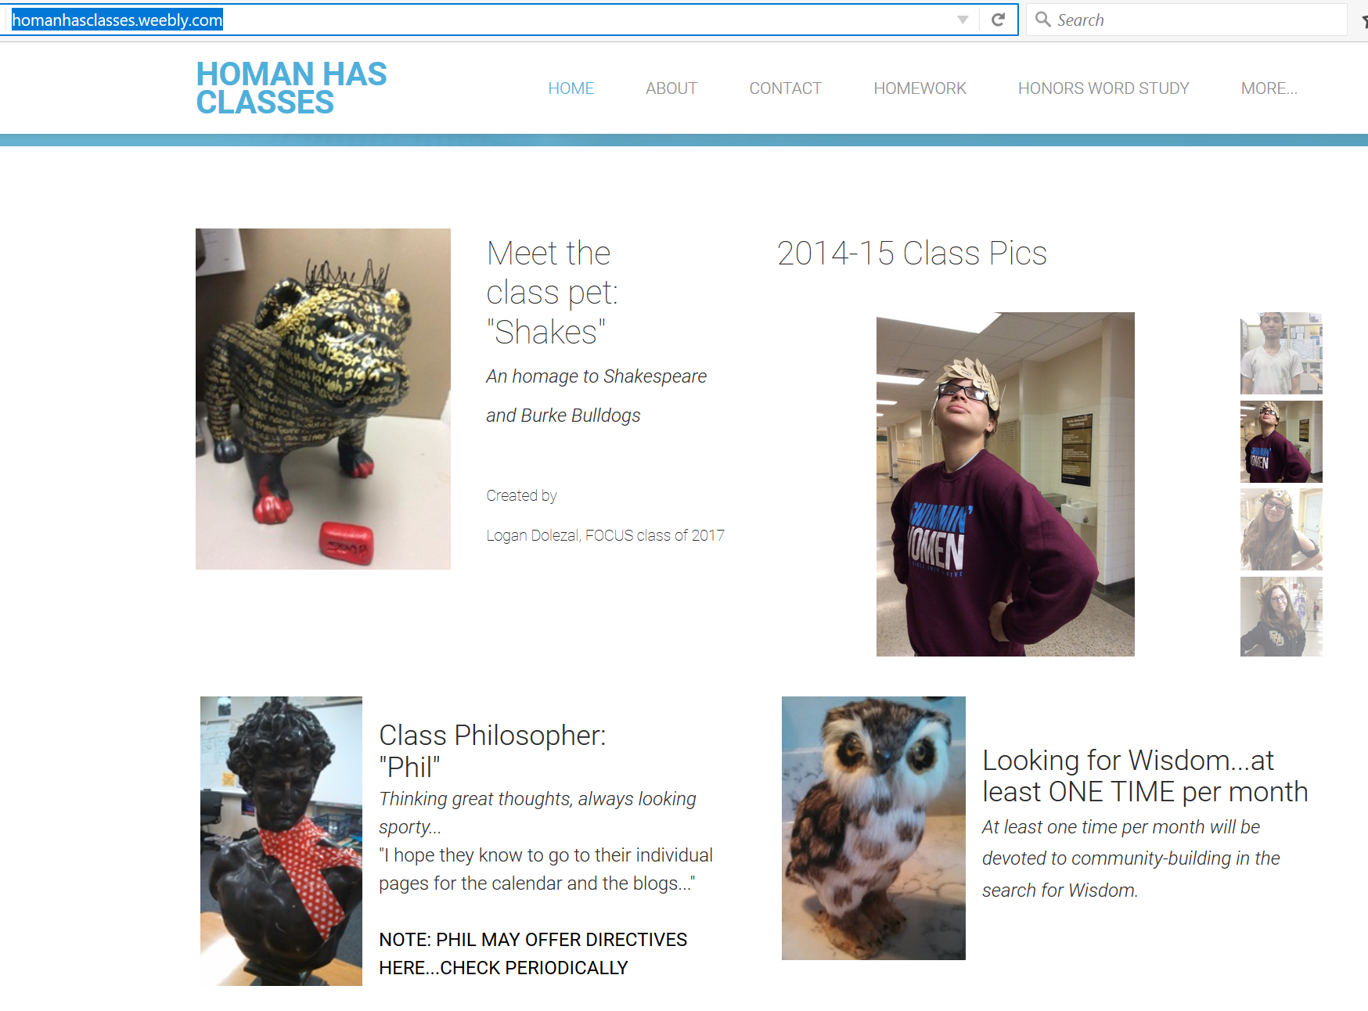
28 August 2017 SWBAT: Use contextual skills to "find wisdom"; defend thesis using evidence
Finding Common Ground
“Finding Wisdom”
http://homanhasclasses.weebly.com/
DBQ Practice
This is where I post PPTS and paper handed out during class
Bellwork (10 minutes)
Agenda (2 minutes)
Skills (20 minutes)
Editing manifesto
Workshop (45 minutes)
Finding Wisdom
Peace/Out (5 minutes)

Slide 11
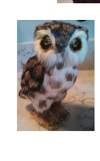
28 August 2017 SWBAT: Use contextual skills to "find wisdom"; defend thesis using evidence
Finding Common Ground
“Finding Wisdom”
http://homanhasclasses.weebly.com/
DBQ Practice
Bellwork (10 minutes)
Agenda (2 minutes)
Skills (20 minutes)
Editing manifesto
Workshop (45 minutes)
Finding Wisdom
Peace/Out (5 minutes)
This is Wisdom.
He is missing.
Find him.
Missing

Slide 12
28 August 2017 SWBAT: Use contextual skills to "find wisdom"; defend thesis using evidence
Finding Common Ground
“Finding Wisdom”
http://homanhasclasses.weebly.com/
DBQ Practice
Bellwork (10 minutes)
Agenda (2 minutes)
Skills (20 minutes)
Editing manifesto
Workshop (45 minutes)
Finding Wisdom
Peace/Out (5 minutes)
You have clues.

Slide 13
August 29, 2016 SWBAT: Explain classroom policies and procedures.
RELATIONSHIPS
HOMEWORK
Bellwork (10 minutes)
Agenda (2 minutes)
Skills (20 minutes)
Editing manifesto
Workshop (45 minutes)
Finding Wisdom
Peace/Out (5 minutes)
Revise manifesto as needed. Add in a quote per category for final product. (check “Imbedding” tool)
Think about “Finding Wisdom” project... Was it fun? Frustrating? Can you make connections b/t the documents and the search?

Slide 14
28 August 2017 SWBAT: Use contextual skills to "find wisdom"; defend thesis using evidence
Finding Common Ground
Using third person.
Write on a piece of scratch paper
MLA HEADING/WITH BLOCK
NONE
Bellwork (20 minutes)
Agenda (2 minutes)
Skills (30 minutes)
Editing exit tickets
Notetaking/Rules
Workshop (30 minutes)
Stations
Supply Drive
Picture
Manifesto
Peace/Out (5 minutes)

