Slide 1
CULTURE
Title: Foreign Exchange/Learner
Who are you are a learner?
What is your attitude toward learning?
How do you know this?
Who were you when you were growing up in school?
How does your ability to be part of the learning process (or not) affect your learning somewhere else?
What strategies do you have in place as a learner that help you now—that would help you somewhere else?
Again—these are things you should be thinking about

Slide 2
This is one of the writing projects
CULTURE
OH—THE PLACES YOU’LL GO
Assignment 5
How is this Trip Going to Benefit You As a Learner?
SELF KNOWLEDGE
MYERS BRIGGS+
YOUR UNDERSTANDING OF SELF
3 paragraphs

Slide 3
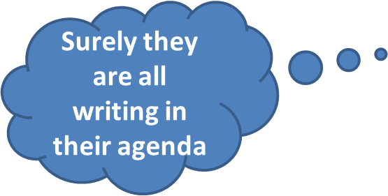
December 7-8, 2015 SWBAT: Use databases to pull “credible” information for research project
UPCOMING- EVEN DAY
THIS WEEK 12/7 Library-all HW: article summary 12/9 E2—Library/all E6– Comp Lab-all Achieve setting HW: project 12/11 E2—Library/all E6—Comp lab-all HW: finish project | NEXT WEEK 12/15-16 PRESENTATIONS

Slide 4
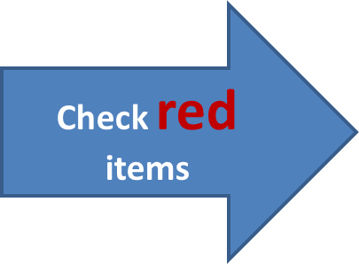
December 7-8, 2015 SWBAT: Use databases to pull “credible” information for research project
UPCOMING- ODD DAY
THIS WEEK 12/8 Workshop Project examples 12/10 Library FULL TIME Achieve setting | NEXT WEEK 12/14 132 FULL TIME 12/17 Presentation 12/18 Presentation

Slide 5
December 7-8, 2015 SWBAT: Use databases to pull “credible” information for research project Bellwork (10 minutes) TEDTalk Agenda (2 minutes) Skill (20 minutes) Research project annotation(20) Workshop (50 minutes) Library Databases Pulling research Peace/Out (2 minutes)
CULTURE
What is this?
Look past the surface impression…

Slide 6
December 7-8, 2015 SWBAT: Use databases to pull “credible” information for research project
SCHEDULE Bellwork (10) Agenda (2) SKILL
Self Reflection (20)
Brainstorming (10) WORKSHOP Project work (45)
Peace/Out (2 minutes)
CULTURE

Slide 7
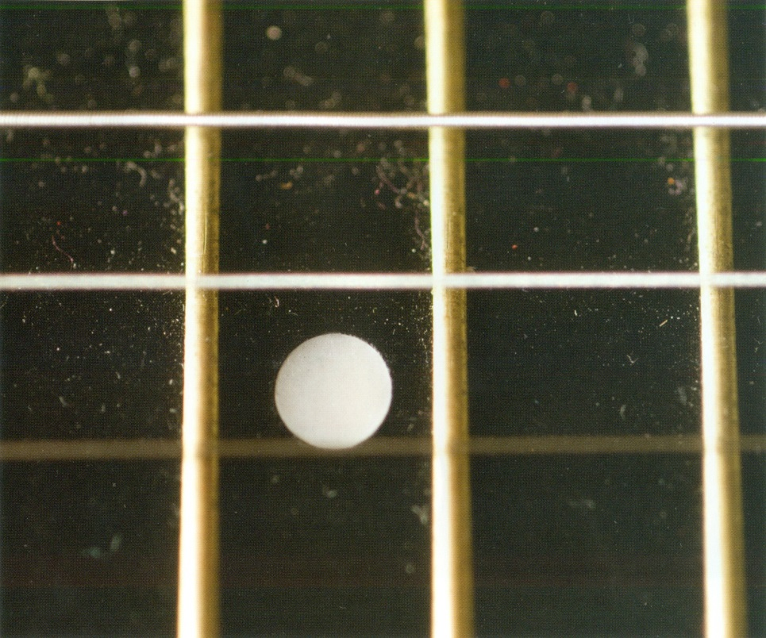
December 7-8, 2015 SWBAT: Use databases to pull “credible” information for research project
SCHEDULE Bellwork (10) Agenda (2) SKILL
Self Reflection (20)
Brainstorming (10) WORKSHOP Project work (45)
Peace/Out (2 minutes)
CULTURE
What is this?
Look past the surface impression…

Slide 8
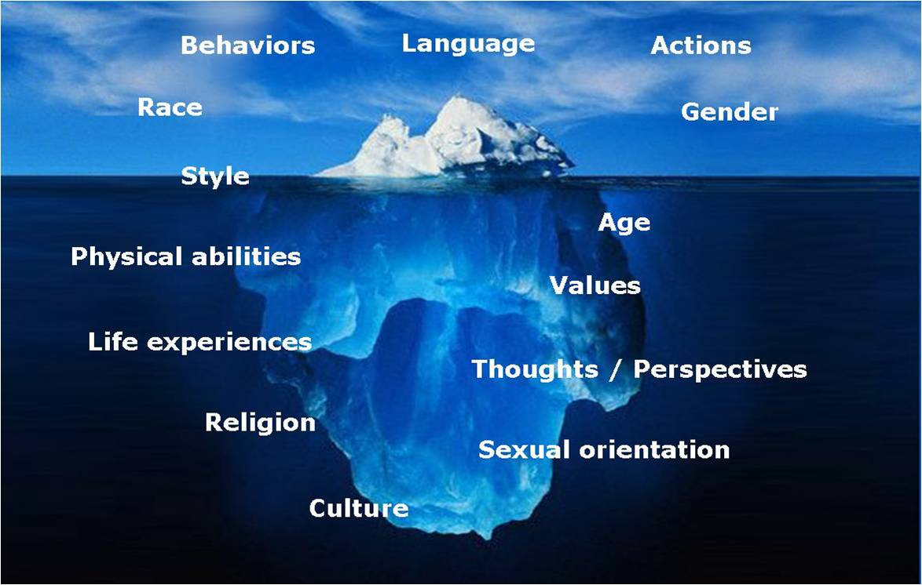
December 7-8, 2015 SWBAT: Use databases to pull “credible” information for research project
Culture
Norms/ Values/ Traits
Culture Project:
You are going on a trip
Bellwork (10 minutes) TEDTalk Agenda (2 minutes) Skill (20 minutes) Research project annotation(20) Workshop (50 minutes) Library Databases Pulling research Peace/Out (2 minutes)

Slide 9
December 7-8, 2015 SWBAT: Use databases to pull “credible” information for research project
Culture
You need to be able to answer these questions—and more
WHERE AM I GOING? (CultureGrams)
Study of obvious: destination, environment, background
WHAT IS HAPPENING? (Library Database)
What will people be talking about? Current events
HOW AM I UNINTENTIONALLY GOING TO OFFEND PEOPLE?
What are the cultural norms/traditions? (CultureGrams, additional)
HOST FAMILY HAS STORIES—WHAT ARE THEY? (Various sites)
What are the stories your peers have grown up on?
Bellwork (10 minutes) TEDTalk Agenda (2 minutes) Skill (20 minutes) Research project annotation(20) Workshop (50 minutes) Library Databases Pulling research Peace/Out (2 minutes)

Slide 10
December 7-8, 2015 SWBAT: Use databases to pull “credible” information for research project
Culture
Bellwork (10 minutes) TEDTalk Agenda (2 minutes) Skill (20 minutes) Research project annotation(20) Workshop (50 minutes) Library Databases Pulling research Peace/Out (2 minutes)
To start you should be able to answer:
How are children viewed?
How are women viewed?
What is considered educated?
What is the government about?
Not this anymore--changed
Stories:
www.listverse.com
www.terrapsych.com

Slide 11
December 7-8, 2015 SWBAT: Use databases to pull “credible” information for research project
CULTURE
Current Event
Summary writing
How is knowing background going to help you acclimate?
Bellwork (10 minutes) TEDTalk Agenda (2 minutes) Skill (20 minutes) Research project annotation(20) Workshop (50 minutes) Library Databases Pulling research Peace/Out (2 minutes)

Slide 12
December 7-8, 2015 SWBAT: Use databases to pull “credible” information for research project
What is your “power verb”?
TONE?
CULTURE
Article Summary
Two paragraphs
The “article”
(ICE techniques)
Summarize the article
2. Why is what you pulled important?
“As a foreign exchange student in _______, knowing this information would benefit a student…
AGENDA
Bellwork (10 minutes) TEDTalk Agenda (2 minutes) Skill (20 minutes) Research project annotation(20) Workshop (50 minutes) Library Databases Pulling research Peace/Out (2 minutes)
Why is article interesting?
Why do the people where you are going care?
Narrative voice?

Slide 13
December 7-8, 2015 SWBAT: Use databases to pull “credible” information for research project
CULTURE
Article Summary
Use a quote or fact from the actual article to go in, then use the standard elements (by who/found where/does what), THEN write information.
This is harder—it requires you to think about the element you want to focus the writing on.
For those who need a challenge
Bellwork (10 minutes) TEDTalk Agenda (2 minutes) Skill (20 minutes) Research project annotation(20) Workshop (50 minutes) Library Databases Pulling research Peace/Out (2 minutes)

Slide 14
December 7-8, 2015 SWBAT: Use databases to pull “credible” information for research project Bellwork (10 minutes) TEDTalk Agenda (2 minutes) Skill (20 minutes) Research project annotation(20) Workshop (50 minutes) Library Databases Pulling research Peace/Out (2 minutes)
CULTURE
HOMEWORK
New: Article annotation and summary.
Old: CultureGrams annotation

