Slide 1
Finding Common Ground
6 November 2017 SWBAT: work with a partner to revise and also create
Bellwork (10 minutes)
Written response to revision #1
Agenda (3 minutes)
Workshop (70)
Stations
Revision
Marketing
Gratitude
Peace/Out (2 minutes)
Bellwork
Metacognition
YN: utensil/paper
You should have revised your Adichi document.
Q: What do you know you missed?
(for many of you—it was the ICE)
Q: What do you know you did well?
(for many of you, it will be the “relate to text”)
Staple and put on back table as noted on board

Slide 2
2 November 2017 SWBAT: use multiple skills
UPCOMING- EVEN DAY
THIS WEEK 11/6 Stations Vocab practice HW: read 11/8 Vocab practice HW: read 11/10 FREE READ Friday Vocab practice HW: read | NEXT WEEK 11/14 Vocab practice HW: read 11/16 Biography “Quiz” Vocab practice HW: study for vocab test VOCAB EXAM 11/20
Put this in your Agenda

Slide 3
6 November 2017 SWBAT: work with a partner to revise and also create
Bellwork (10 minutes)
Written response to revision #1
Agenda (3 minutes)
Workshop (70)
Stations
Revision
Marketing
Gratitude
Peace/Out (2 minutes)
Finding Common Ground
HOMEWORK
1. read

Slide 4
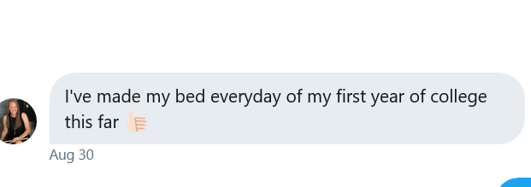
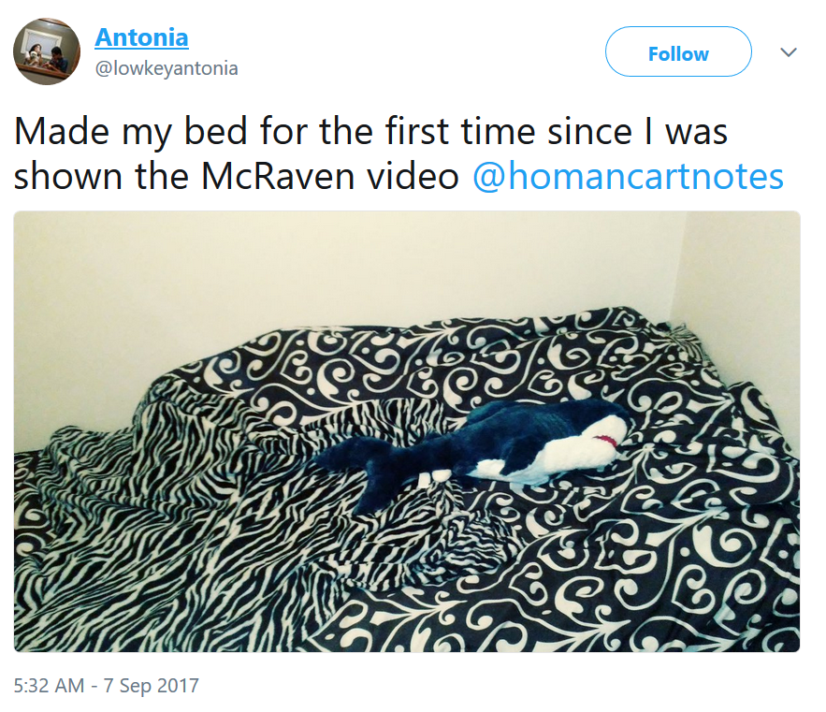
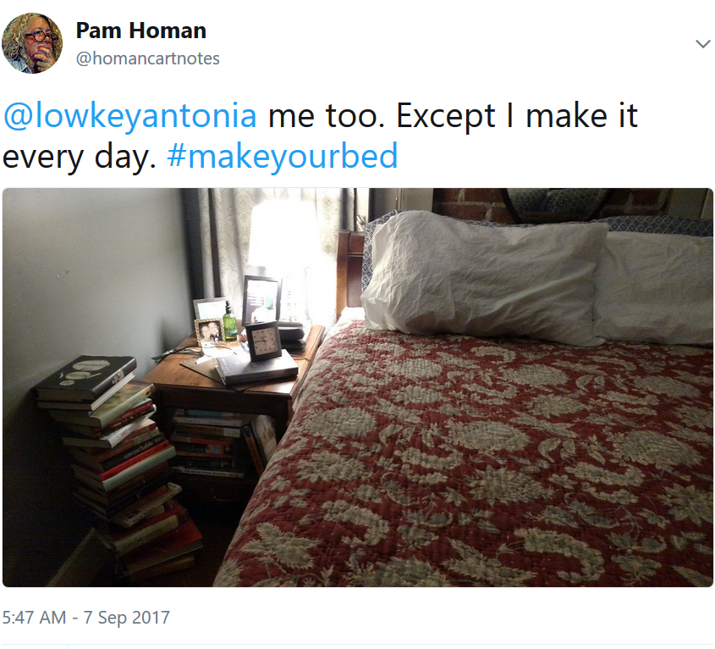
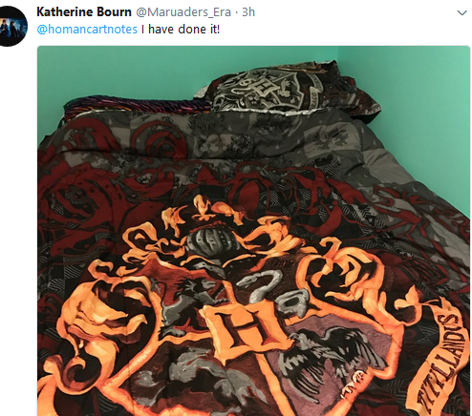
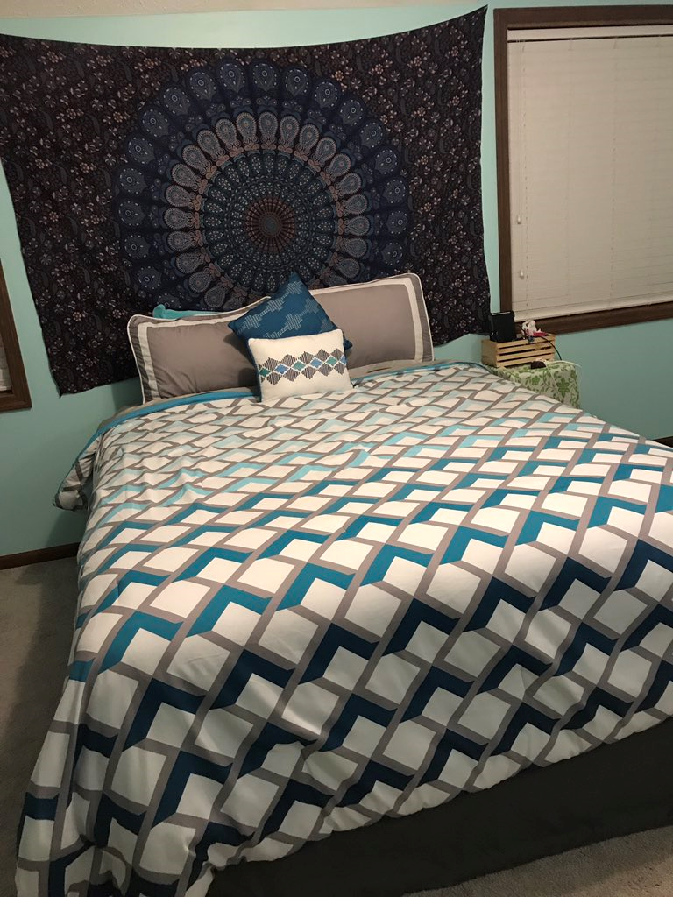
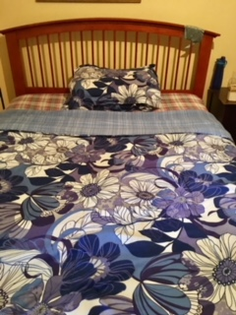
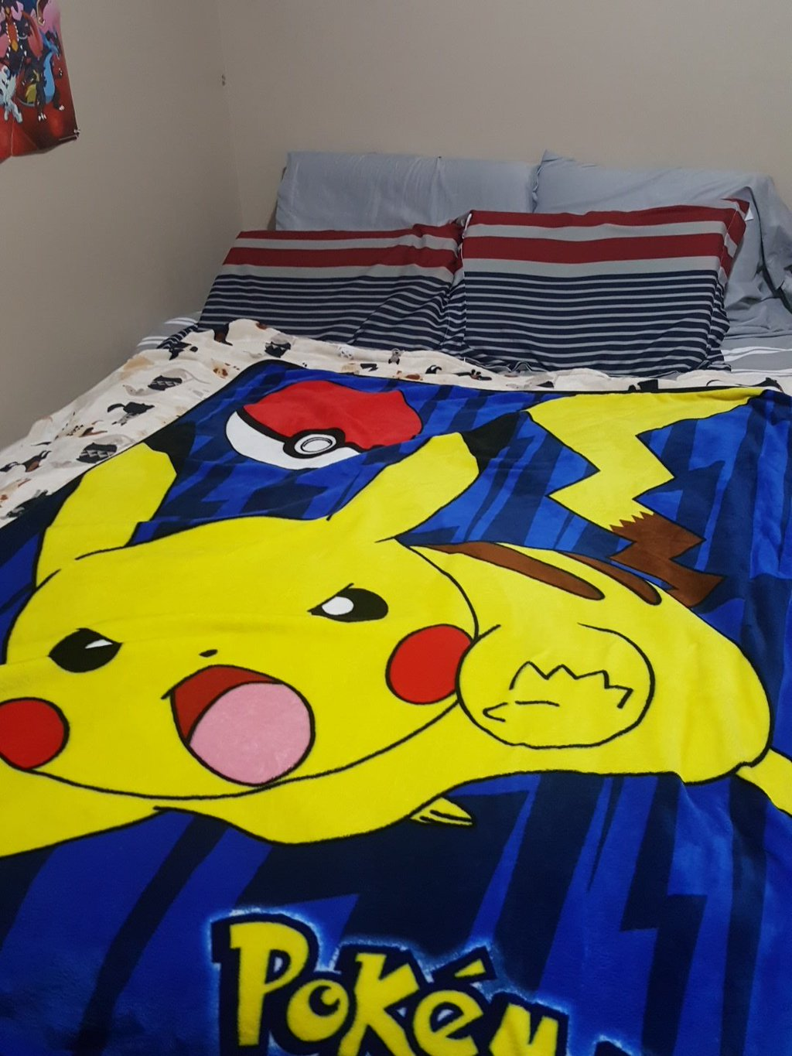
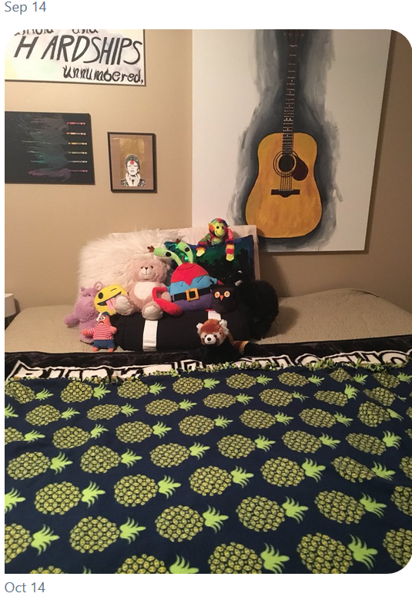
2 November 2017 6 November 2017 SWBAT: work with a partner to revise and also create
Bellwork (10 minutes)
Written response to revision #1
Agenda (3 minutes)
Workshop (70)
Stations
Revision
Marketing
Gratitude
Peace/Out (2 minutes)
Finding Common Ground
#makeyourbed beds

Slide 5
2 November 2017 6 November 2017 SWBAT: work with a partner to revise and also create
Bellwork (10 minutes)
Written response to revision #1
Agenda (3 minutes)
Workshop (70)
Stations
Revision
Marketing
Gratitude
Peace/Out (2 minutes)
A Matter of Life and Death
Students will: utilize multiple literacies
STATIONS
Fix It New piece of paper. What was not correct? Fix it Can use 1 partner WRITTEN EXPLANATION OF WHAT YOU MISSED | Marketing I Create the posters Sign up for reading Marketing II Using RHETORICAL TECHNIQUES, write the scripts for the coat drive campaign. | Appreciation Wall Finish braiding the “rope” for the “gratitude” station

Slide 6
2 November 2017
A Matter of Life and Death
Students will: review element missed on their OPS Unit 1 test, have opportunity to work with partner to reflect and revise
YN: your test/writing utensil
What did you miss?
What is correct answer?
Why do you think you missed it?
Ex: “I missed #3. I answered C, but it was really D—my mistake was I misread the question. I think if I could have annotated the document, I would have underlined so I could understand what it asked…”
Fix It: Revision
STATION: Fix It

Slide 7
2 November 2017
A Matter of Life and Death
Students will: create series of posters to advertise a coat drive running from November 6-29
YN: your brain/my supplies
Create a series of posters to advertise
Burke Coat Drive
Use information from Socktober
(Ex: # of homeless)
5W’s must be represented on poster
“Marketing”
STATION: Marketing 1

Slide 8
2 November 2017
A Matter of Life and Death
Students will: create series of “advertisement”
to market coat drive
YN: your brain/notes on rhetorical appeals
Create a series of “ads” to read during morning announcements
Burke Coat Drive
5W’s must be represented in writing
I must see the “rhetorical appeal” being utilized.
MENTAL CREDIT FOR SAT WORDS
“Marketing”
STATION: Marketing 2

Slide 9
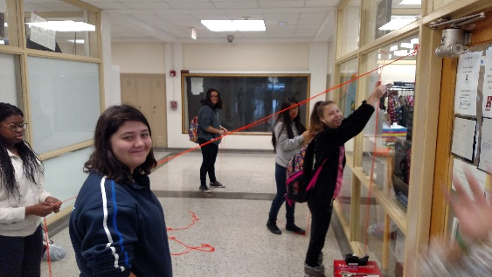
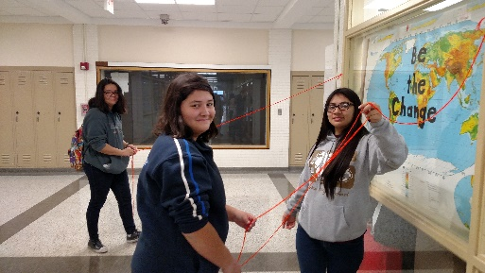
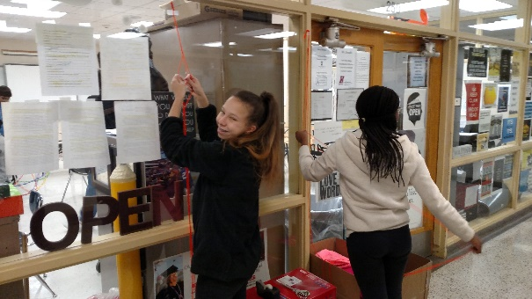
2 November 2017
A Matter of Life and Death
Students will: establish “gratitude wall”
YN: your dexterity/patience
Finish braiding the yarn ropes so we can hang gratitude tags, positive messages for others
Exhibit Gratitude
STATION: Gratitude Wall

Slide 10
2 November 2017 6 November 2017 SWBAT: work with a partner to revise and also create
Bellwork (10 minutes)
Written response to revision #1
Agenda (3 minutes)
Workshop (70)
Stations
Revision
Marketing
Gratitude
Peace/Out (2 minutes)
Finding Common Ground
HOMEWORK
1. read

Slide 11
2 November 2017 6 November 2017 SWBAT: work with a partner to revise and also create
Bellwork (10 minutes)
Written response to revision #1
Agenda (3 minutes)
Workshop (70)
Stations
Revision
Marketing
Gratitude
Peace/Out (2 minutes)
Finding Common Ground
Write on a piece of scratch paper
Did you have things to revise?
PLEASE USE MLA HEADING

