Slide 1
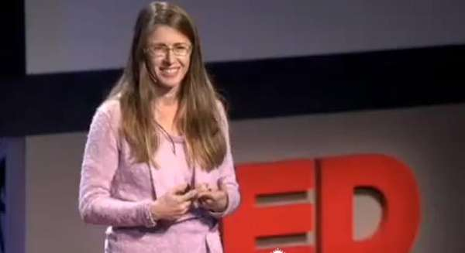
Finding Common Ground
2 November 2017 SWBAT: use multiple skills
Bellwork (15 minutes)
Respond to video
Agenda (3 minutes)
Skill (20)
Analysis of writing
Workshop (40)
Stations
Vocabulary
Revision
Marketing
Peace/Out (2 minutes)
Bellwork
Life Lessons
YN: utensil/paper
Are there times you know YOU should do this—what is stopping you?
Are there times when you wish others WOULD do this? Does it affect you?
https://www.ted.com/playlists/206/give_thanks

Slide 2
2 November 2017 SWBAT: use multiple skills
Bellwork (15 minutes)
Respond to video
Agenda (3 minutes)
Skill (20)
Analysis of writing
Workshop (40)
Stations
Vocabulary
Revision
Marketing
Peace/Out (2 minutes)
Finding Common Ground
Bellwork
Life Lessons
YN: utensil/paper
TEDTalk
Dr. Laura Trice:
“Remember to say thank you”
https://www.ted.com/playlists/206/give_thanks

Slide 3
2 November 2017 SWBAT: use multiple skills
UPCOMING- EVEN DAY
THIS WEEK 10/31 Vocab practice HW: read 11/2 Stations Vocab practice HW: read | NEXT WEEK 11/6 Stations Vocab practice HW: read 11/8 Vocab practice HW: read 11/10 FREE READ Friday Vocab practice HW: read Bio is DONE 11/16 VOCAB EXAM 11/20
Put this in your Agenda

Slide 4
2 November 2017 SWBAT: use multiple skills
Bellwork (15 minutes)
Respond to video
Agenda (3 minutes)
Skill (20)
Analysis of writing
Workshop (40)
Stations
Vocabulary
Revision
Marketing
Peace/Out (2 minutes)
Finding Common Ground
HOMEWORK
1. Finish revisions

Slide 5
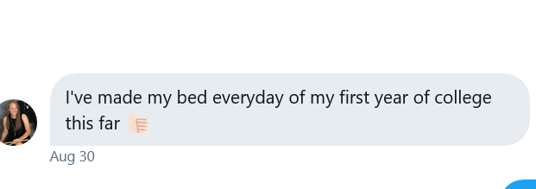
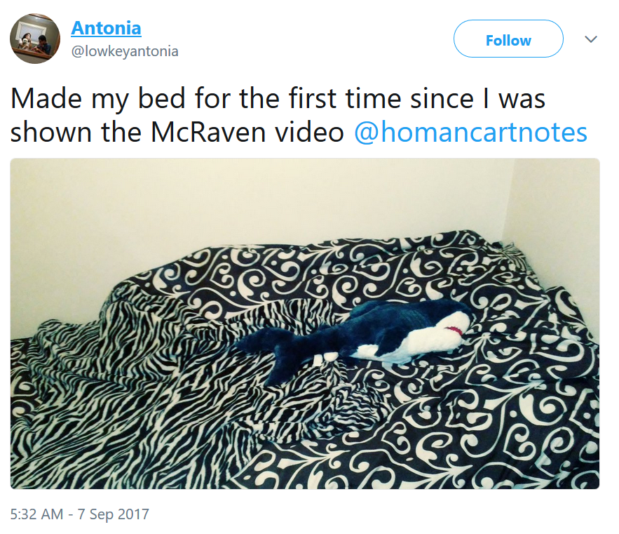
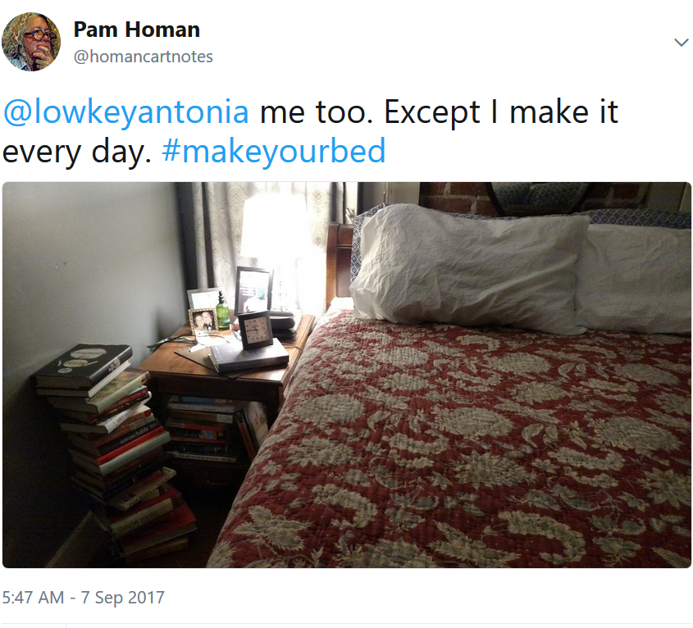
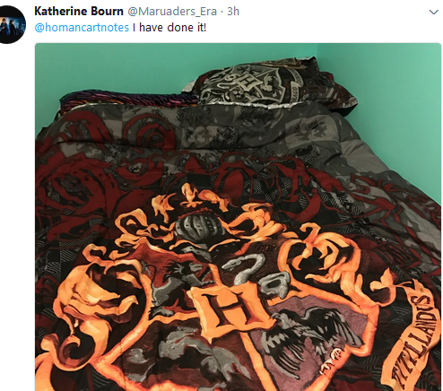
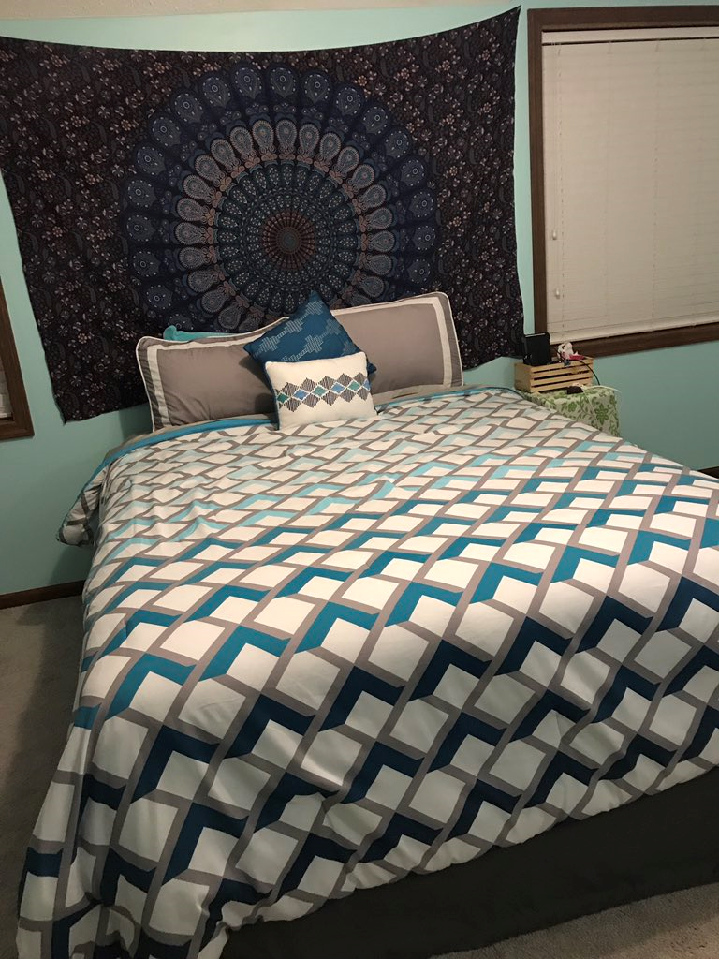
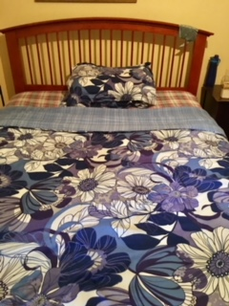
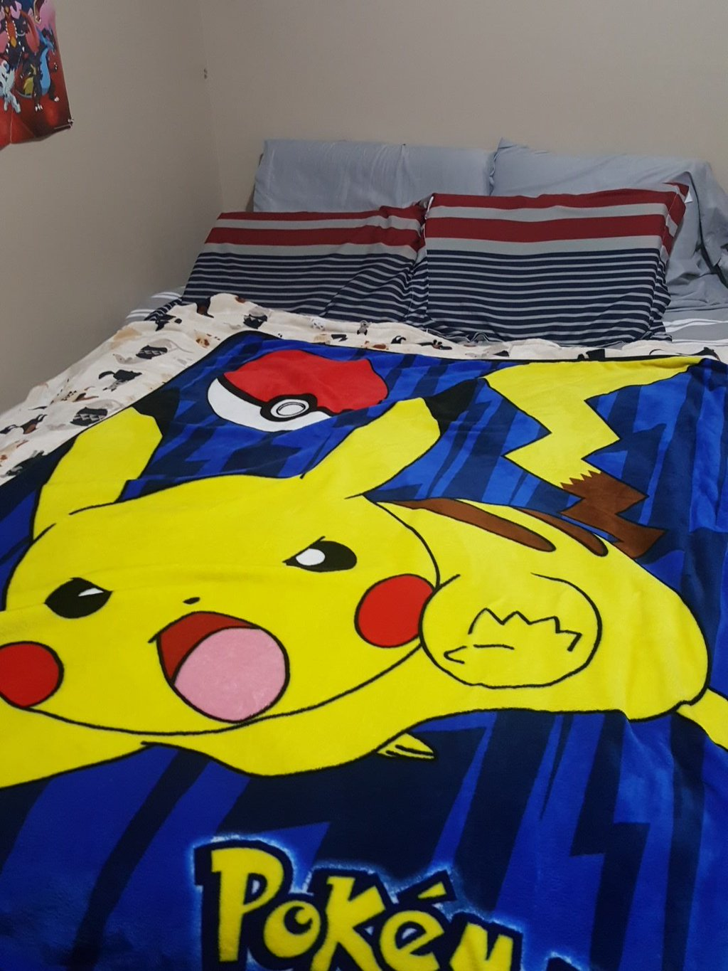
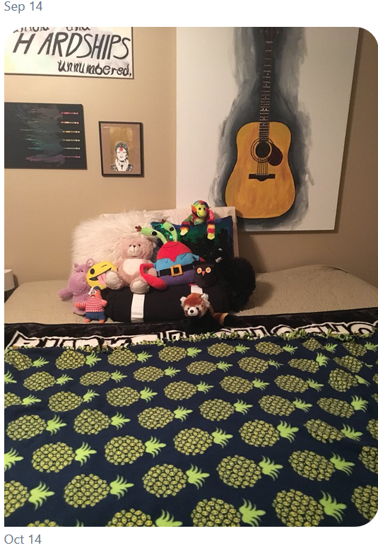
2 November 2017 SWBAT: use multiple skills
Bellwork (15 minutes)
Respond to video
Agenda (3 minutes)
Skill (20)
Analysis of writing
Workshop (40)
Stations
Vocabulary
Revision
Marketing
Peace/Out (2 minutes)
Finding Common Ground
#makeyourbed beds

Slide 6
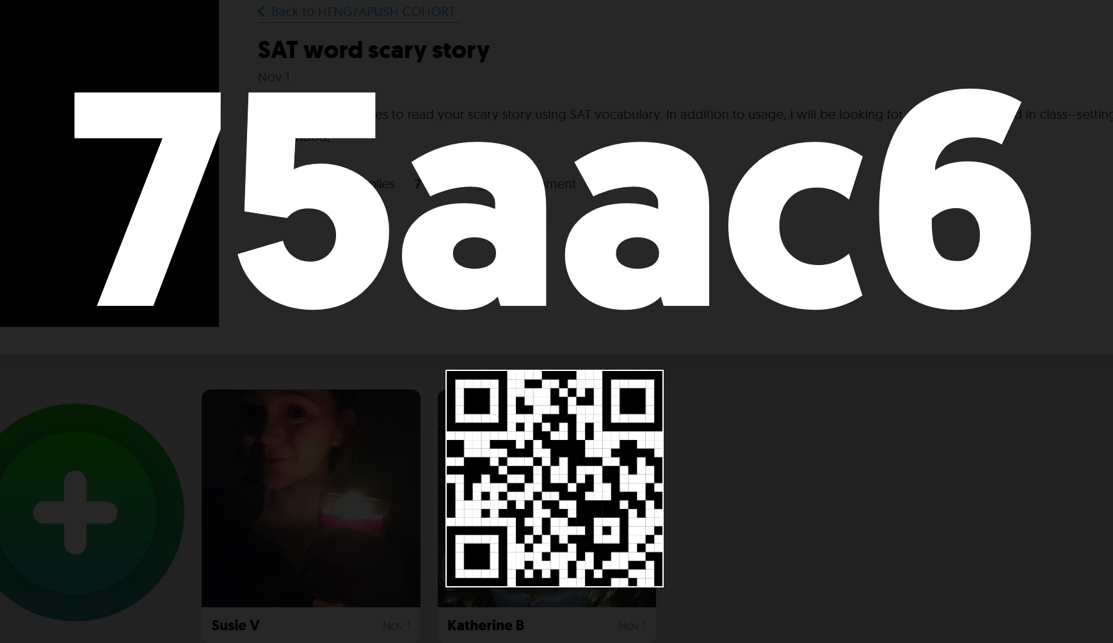
2 November 2017 SWBAT: use multiple skills
Bellwork (15 minutes)
Respond to video
Agenda (3 minutes)
Skill (20)
Analysis of writing
Workshop (40)
Stations
Vocabulary
Revision
Marketing
Peace/Out (2 minutes)
A Matter of Life and Death
Students will: utilize multiple literacies
STATIONS
FLIPGRID or Written Response Listen to the prompt Turn in or record response. Looking for SPECIFIC examples to support understanding of the words. | Fix It Annotate ICE document Look at YOUR writing What was not correct? Fix it | Marketing Create the posters Sign up for reading Using RHETORICAL TECHNIQUES, write the scripts for the coat drive campaign.

Slide 7
2 November 2017 SWBAT: use multiple skills
Bellwork (15 minutes)
Respond to video
Agenda (3 minutes)
Skill (20)
Analysis of writing
Workshop (40)
Stations
Vocabulary
Revision
Marketing
Peace/Out (2 minutes)
A Matter of Life and Death
Students will: identify issues in their own writing
YN: ICE document/homework/writing utensil
ARE YOU DOING THIS?
ARE YOU MAKING A CLAIM AND SUPPORTING WITH EVIDENCE?
ARE YOU USING DEAD WORDS?
ARE YOU USING CONTRACTIONS?
Word choice? Could you be using better words?
Self Awareness of Writing

Slide 8
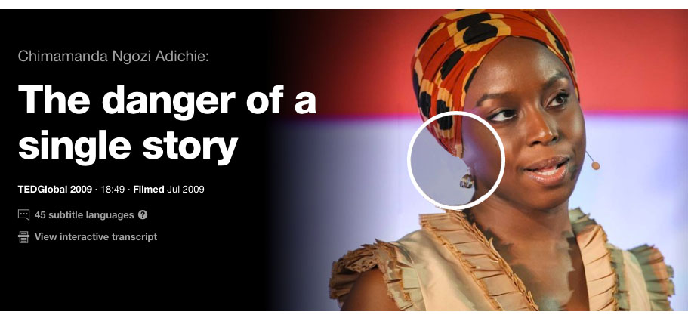
2 November 2017 SWBAT: use multiple skills
Bellwork (15 minutes)
Respond to video
Agenda (3 minutes)
Skill (20)
Analysis of writing
Workshop (40)
Stations
Vocabulary
Revision
Marketing
Peace/Out (2 minutes)
A Matter of Life and Death
Station 1
FIX IT/Revise
Bellwork
Life Lessons
YN: utensil/paper
Anything in this video that makes you think “wow?”
Can you think of a time where you know you have done this?
How does the act of banning/challenging limit us to a single story?
Are you aware of “curating” your social media? Does this limit either you or others knowledge? Does this matter?

Slide 9
2 November 2017 SWBAT: use multiple skills
Bellwork (15 minutes)
Respond to video
Agenda (3 minutes)
Skill (20)
Analysis of writing
Workshop (40)
Stations
Vocabulary
Revision
Marketing
Peace/Out (2 minutes)
A Matter of Life and Death
Station 1
FIX IT/REVISE?
Bellwork
Quickwrite
YN: writing utensil/paper/ “Island of the Dolls”
Did the video scare you at all?
How does setting/tone/mood play into your reaction?
Ex: The video: “The Island of the Dolls” found on Youtube is terrifying on many levels. The setting, an island, lends itself to creepiness—the isolation one could feel surrounded by water, stuck, alone, forces the viewer to imagine…

Slide 10
2 November 2017 SWBAT: use multiple skills
Bellwork (15 minutes)
Respond to video
Agenda (3 minutes)
Skill (20)
Analysis of writing
Workshop (40)
Stations
Vocabulary
Revision
Marketing
Peace/Out (2 minutes)
A Matter of Life and Death
Students will: identify setting/tone/mood in mentor text
YN: book/paper/writing utensil
You are identifying how setting/tone/mood/word choice
make listener connect
OF COURSE YOU ARE CITING THE BOOK/AUTHOR/STORY
Literary Analysis
Station 1
FIX IT/REVISE?

Slide 11
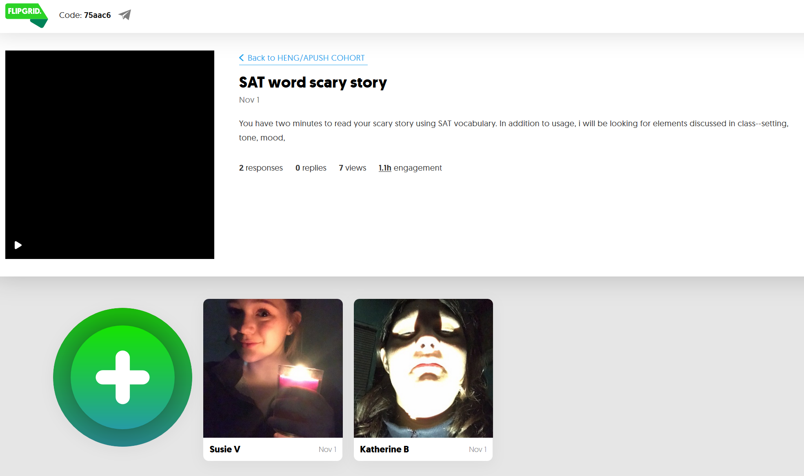
2 November 2017 SWBAT: use multiple skills
Bellwork (15 minutes)
Respond to video
Agenda (3 minutes)
Skill (20)
Analysis of writing
Workshop (40)
Stations
Vocabulary
Revision
Marketing
Peace/Out (2 minutes)
Finding Common Ground
Students will: demonstrate understanding of SAT vocabulary
Flipgrid
In writing
Demonstrate Knowledge

Slide 12
2 November 2017 SWBAT: use multiple skills
Bellwork (15 minutes)
Respond to video
Agenda (3 minutes)
Skill (20)
Analysis of writing
Workshop (40)
Stations
Vocabulary
Revision
Marketing
Peace/Out (2 minutes)
A Matter of Life and Death
Students will: continue practicing usage of SAT-level words
YN: vocabulary cards/writing utensil/paper
Note: I will be looking for your ability to establish setting/tone/mood in addition to vocabulary
Note: “Mental credit” for use of UNIT 1 words in your clues
Vocabulary Practice
Station 2
FLIPGRID
OR JUST SUBMIT

Slide 13
2 November 2017 SWBAT: use multiple skills
Bellwork (15 minutes)
Respond to video
Agenda (3 minutes)
Skill (20)
Analysis of writing
Workshop (40)
Stations
Vocabulary
Revision
Marketing
Peace/Out (2 minutes)
Finding Common Ground
HOMEWORK
1. Finish revisions

Slide 14
2 November 2017 SWBAT: use multiple skills
Bellwork (15 minutes)
Respond to video
Agenda (3 minutes)
Skill (20)
Analysis of writing
Workshop (40)
Stations
Vocabulary
Revision
Marketing
Peace/Out (2 minutes)
Finding Common Ground
Write on a piece of scratch paper
Did you have things to revise?
PLEASE USE MLA HEADING

