Slide 1
31 October 2017 SWBAT: determine how an author uses tone/mood as part of establishing setting
A Matter of Life and Death
Bellwork
Listening
YN: writing utensil/paper/ “Island of the Dolls”
https://www.youtube.com/watch?v=GoyINeeyWFg
Watch video
Take notes
I will asking questions about setting/tone/mood…you will reflect answer using proper ICE techniques
Bellwork (15 minutes)
Island of the Dolls
Agenda (3 minutes)
Skill (20)
Listening/notetaking
Workshop (40)
Vocab review
Storywriting
Reading
Peace/Out (2 minutes)

Slide 2
31 October 2017 SWBAT: determine how an author uses tone/mood as part of establishing setting
A Matter of Life and Death
Setting
(where/when is it taking place?)
Author: consciously choosing, establishes a conscious or unconscious response in audience.
Establishes time/place
Reader: is influenced by similarities, differences. Ex: high schoolers understand experience of high school, BUT might not initially relate to a setting of high school in the 70’s. Need to understand what was happening at that time in order to understand motivations of character.
Bellwork (15 minutes)
Island of the Dolls
Agenda (3 minutes)
Skill (20)
Listening/notetaking
Workshop (40)
Vocab review
Storywriting
Reading
Peace/Out (2 minutes)

Slide 3
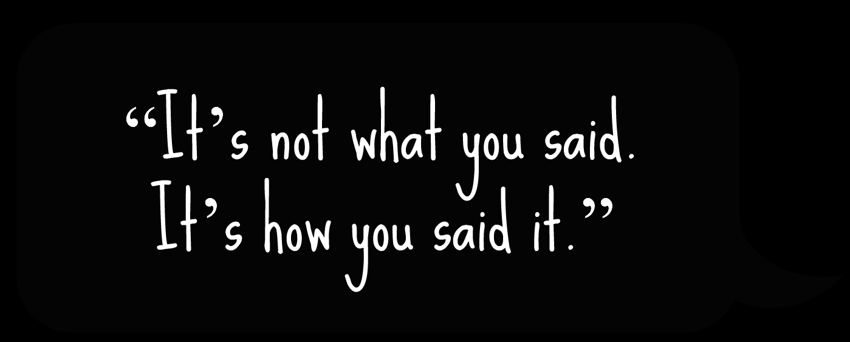
31 October 2017 SWBAT: determine how an author uses tone/mood as part of establishing setting
A Matter of Life and Death
Tone
(how does it SOUND?)
Author: Words used to establish attitude toward content/character
Reader: is influenced by word choice;
might allow reader to make inferences
Bias could be part of this
Bellwork (15 minutes)
Island of the Dolls
Agenda (3 minutes)
Skill (20)
Listening/notetaking
Workshop (40)
Vocab review
Storywriting
Reading
Peace/Out (2 minutes)

Slide 4
31 October 2017 SWBAT: determine how an author uses tone/mood as part of establishing setting
A Matter of Life and Death
Mood
(how does it FEEL?)
Author: Words used to establish emotional response from reader
Reader: is influenced by word choice;
might allow reader to connect/ make inferences about character
Bellwork (15 minutes)
Island of the Dolls
Agenda (3 minutes)
Skill (20)
Listening/notetaking
Workshop (40)
Vocab review
Storywriting
Reading
Peace/Out (2 minutes)

Slide 5
31 October 2017 SWBAT: determine how an author uses tone/mood as part of establishing setting
A Matter of Life and Death
ICE Techniques
Proper citations
Introduce—what is the “vehicle”
Cite– who is it by?/what is it called?
Explain– what does it “do”?
.
Bellwork (15 minutes)
Island of the Dolls
Agenda (3 minutes)
Skill (20)
Listening/notetaking
Workshop (40)
Vocab review
Storywriting
Reading
Peace/Out (2 minutes)

Slide 6
31 October 2017 SWBAT: determine how an author uses tone/mood as part of establishing setting
A Matter of Life and Death
Bellwork
Quickwrite
YN: writing utensil/paper/ “Island of the Dolls”
Did the video scare you at all?
How does setting/tone/mood play into your reaction?
Ex: The video: “The Island of the Dolls” found on Youtube is terrifying on many levels. The setting, an island, lends itself to creepiness—the isolation one could feel surrounded by water, stuck, alone, forces the viewer to imagine…
Bellwork (15 minutes)
Island of the Dolls
Agenda (3 minutes)
Skill (20)
Listening/notetaking
Workshop (40)
Vocab review
Storywriting
Reading
Peace/Out (2 minutes)

Slide 7
31 October 2017 SWBAT: determine how an author uses tone/mood as part of establishing setting
UPCOMING- EVEN DAY
THIS WEEK 10/31 Vocab practice HW: read 11/2 Stations Vocab practice HW: read | NEXT WEEK 11/6 Vocab practice HW: read 11/8 Vocab practice HW: read 11/10 Vocab practice HW: read Bio is DONE 11/16 VOCAB EXAM 11/20
Put this in your Agenda

Slide 8
31 October 2017 SWBAT: determine how an author uses tone/mood as part of establishing setting
A Matter of Life and Death
HOMEWORK
Bellwork (15 minutes)
Island of the Dolls
Agenda (3 minutes)
Skill (20)
Listening/notetaking
Workshop (40)
Vocab review
Storywriting
Reading
Peace/Out (2 minutes)
Finish the vocab story
Finish the literary analysis
Read your biography

Slide 9
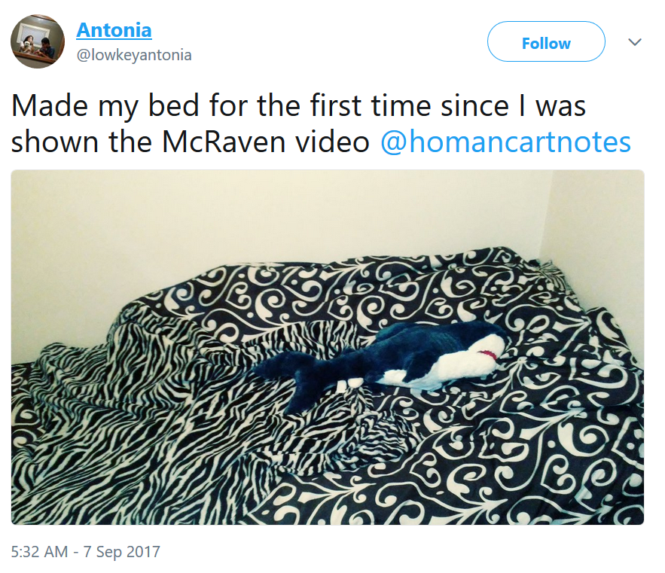
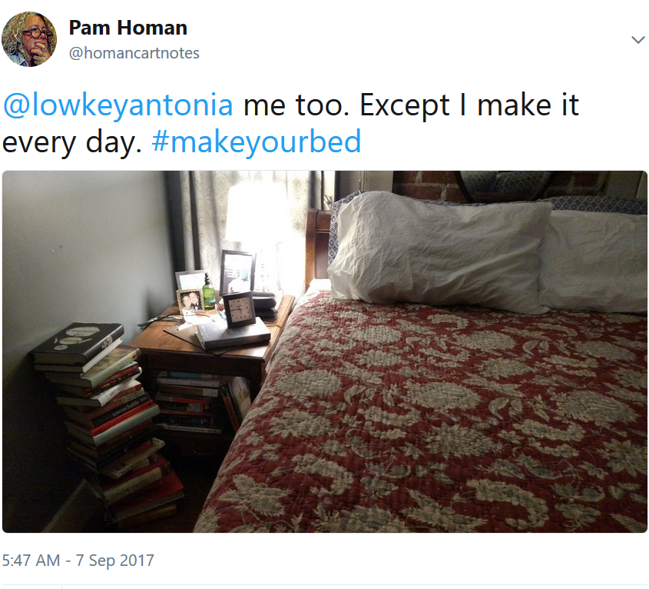
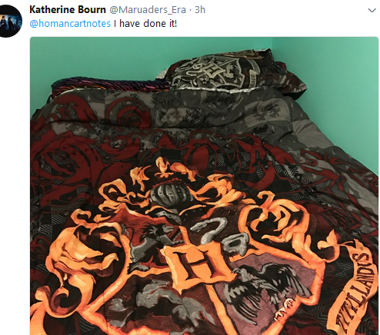
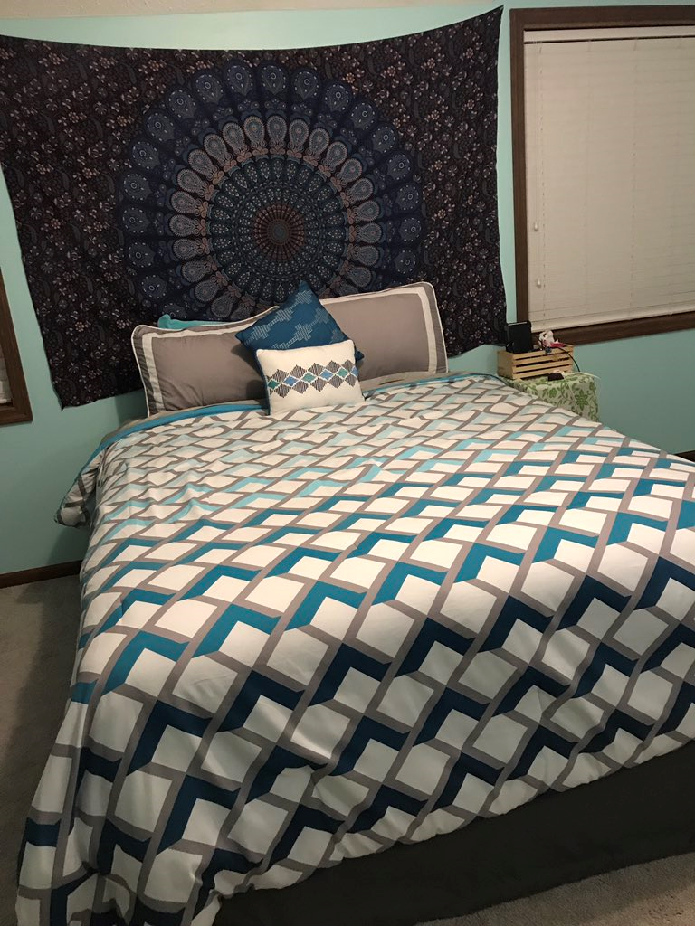
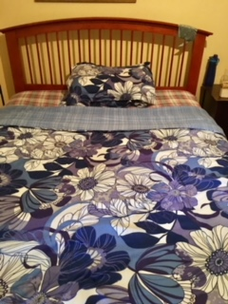
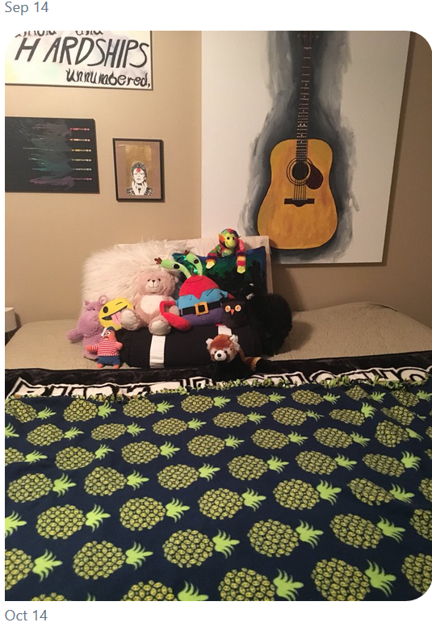
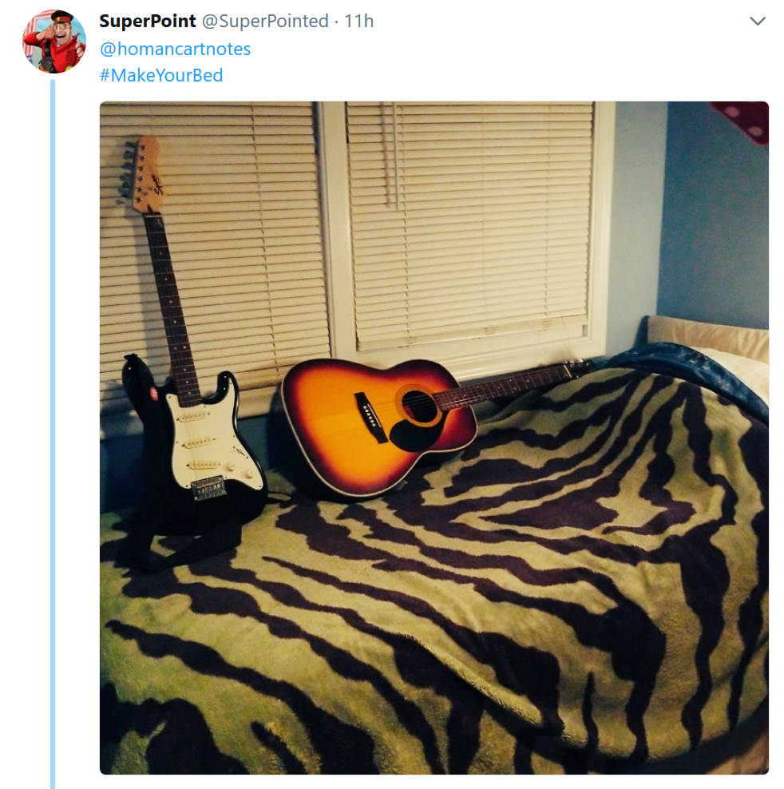
31 October 2017 SWBAT: determine how an author uses tone/mood as part of establishing setting
A Matter of Life and Death
#makeyourbed beds
Bellwork (15 minutes)
Island of the Dolls
Agenda (3 minutes)
Skill (20)
Listening/notetaking
Workshop (40)
Vocab review
Storywriting
Reading
Peace/Out (2 minutes)

Slide 10
31 October 2017 SWBAT: determine how an author uses tone/mood as part of establishing setting
A Matter of Life and Death
Quick Write
Reflection from P/T Conferences
Consider:
How does YOUR learning style allow you to access information?
How could you apply this knowledge to studying?
As a auditory learner:
(you want to hear—say outloud)
As a visual learner:
(you want to WATCH—find videos)
Bellwork (15 minutes)
Island of the Dolls
Agenda (3 minutes)
Skill (20)
Listening/notetaking
Workshop (40)
Vocab review
Storywriting
Reading
Peace/Out (2 minutes)

Slide 11
31 October 2017 SWBAT: determine how an author uses tone/mood as part of establishing setting
A Matter of Life and Death
Consider:
Are you a fiction or non-fiction person?
Why?
Bellwork (15 minutes)
Island of the Dolls
Agenda (3 minutes)
Skill (20)
Listening/notetaking
Workshop (40)
Vocab review
Storywriting
Reading
Peace/Out (2 minutes)

Slide 12
31 October 2017 SWBAT: determine how an author uses tone/mood as part of establishing setting
A Matter of Life and Death
Students will: identify setting/tone/mood in mentor text
YN: book/paper/writing utensil
Three groups
1 reader per group
Remainder are listening
Listening Skills
Bellwork (15 minutes)
Island of the Dolls
Agenda (3 minutes)
Skill (20)
Listening/notetaking
Workshop (40)
Vocab review
Storywriting
Reading
Peace/Out (2 minutes)

Slide 13
31 October 2017 SWBAT: determine how an author uses tone/mood as part of establishing setting
A Matter of Life and Death
Students will: identify setting/tone/mood in mentor text
YN: book/paper/writing utensil
Reader: I am listening to “voice”
(be aware—I will ask how you chose to read the way you read)
Listening Skills
Bellwork (15 minutes)
Island of the Dolls
Agenda (3 minutes)
Skill (20)
Listening/notetaking
Workshop (40)
Vocab review
Storywriting
Reading
Peace/Out (2 minutes)

Slide 14
31 October 2017 SWBAT: determine how an author uses tone/mood as part of establishing setting
A Matter of Life and Death
Students will: identify setting/tone/mood in mentor text
YN: book/paper/writing utensil
You are identifying how setting/tone/mood/word choice
make listener connect
OF COURSE YOU ARE CITING THE BOOK/AUTHOR/STORY
Literary Analysis
Bellwork (15 minutes)
Island of the Dolls
Agenda (3 minutes)
Skill (20)
Listening/notetaking
Workshop (40)
Vocab review
Storywriting
Reading
Peace/Out (2 minutes)

Slide 15
31 October 2017 SWBAT: determine how an author uses tone/mood as part of establishing setting
A Matter of Life and Death
Students will: continue practicing usage of SAT-level words
YN: vocabulary cards/writing utensil/paper
Tell me a spooky story using UNIT 2
vocabulary words
Vocabulary Practice
Bellwork (15 minutes)
Island of the Dolls
Agenda (3 minutes)
Skill (20)
Listening/notetaking
Workshop (40)
Vocab review
Storywriting
Reading
Peace/Out (2 minutes)

Slide 16
31 October 2017 SWBAT: determine how an author uses tone/mood as part of establishing setting
A Matter of Life and Death
Students will: continue practicing usage of SAT-level words
YN: vocabulary cards/writing utensil/paper
Note: I will be looking for your ability to establish setting/tone/mood in addition to vocabulary
Note: “Mental credit” for use of UNIT 1 words in your clues
Vocabulary Practice
Bellwork (40 minutes)
Single Story
Agenda (3 minutes)
Skill Writing
Workshop (40)
MAPS
Vocabulary
MOSAIC
Peace/Out (2 minutes)

Slide 17
31 October 2017 SWBAT: determine how an author uses tone/mood as part of establishing setting
A Matter of Life and
Death
HOMEWORK
Bellwork (40 minutes)
Single Story
Agenda (3 minutes)
Skill Writing
Workshop (40)
MAPS
Vocabulary
MOSAIC
Peace/Out (2 minutes)
Finish the vocab story
Finish the literary analysis
Read your biography

Slide 18
31 October 2017 SWBAT: determine how an author uses tone/mood as part of establishing setting
A Matter of Life and Death
Write on a piece of scratch paper
Name/Teacher/Block/Date
Tell me a scary story in six words
PLEASE USE MLA HEADING
Bellwork (40 minutes)
Single Story
Agenda (3 minutes)
Skill Writing
Workshop (40)
MAPS
Vocabulary
MOSAIC
Peace/Out (2 minutes)

