Slide 1
3 October 2017 SWBAT: analyze the use of literary devices in writing
Finding Common Ground
YN: The Dot project writing from wall
1. Please remove your “The Dot” writing
(the description of the project) from the wall and put into your notebooks.
I made edits and there is a grade in gradebook.

Slide 2
3 October 2017 SWBAT analyze the use of literary devices in writing
UPCOMING- EVEN DAY
THIS WEEK 10/3 Novel discussion Stations Vocab practice HW: various novel assignments 10/5 Stations Vocab practice HW: TBD | NEXT WEEK 10/9 (SUB) Essay drafting Vocab practice HW: Body-novel 10/11 Peer Edit-Novel Workshop-Censorship Vocab practice HW: Body-Censorship 10/13 Vocab Exam Peer Edit-Censorship WS: Intro/Conclusion HW: Intro/Conclusion
Put this in your Agenda

Slide 3
3 October 2017 SWBAT: analyze the use of literary and rhetorical devices in writing
Finding Common Ground
HOMEWORK
Bellwork (5 minutes)
Agenda (3 minutes)
Workshop
Stations
Peace/Out (2 minutes)
1. Study your vocabulary

Slide 4
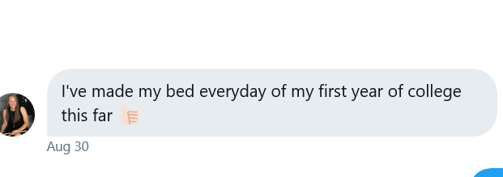
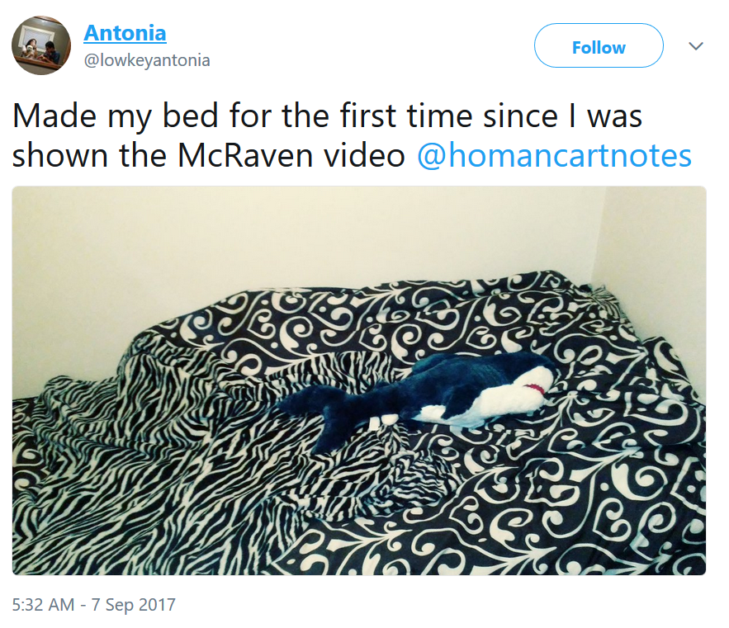
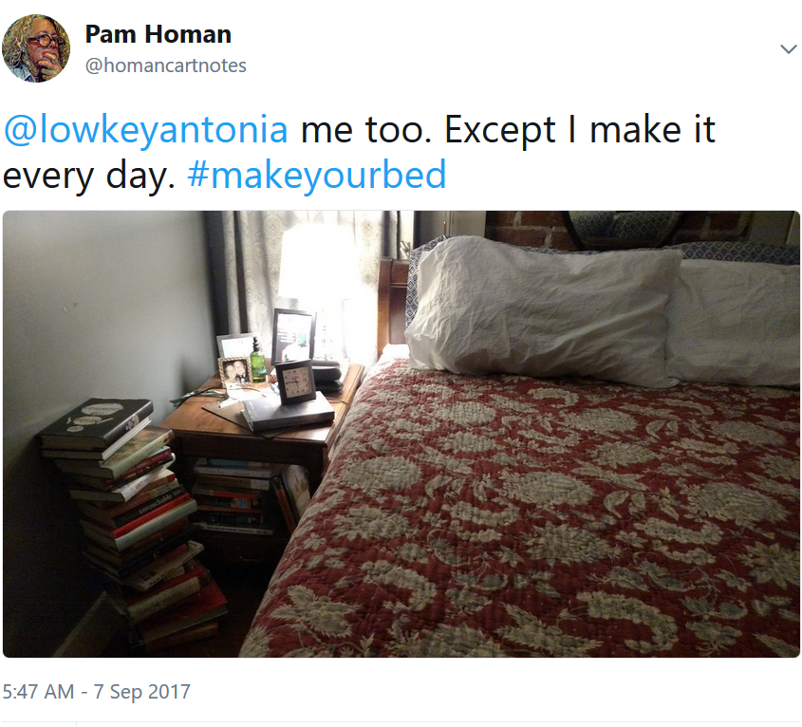
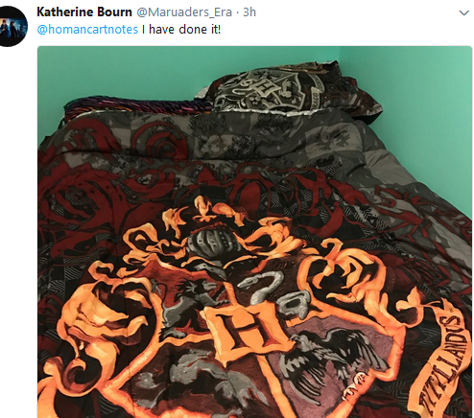
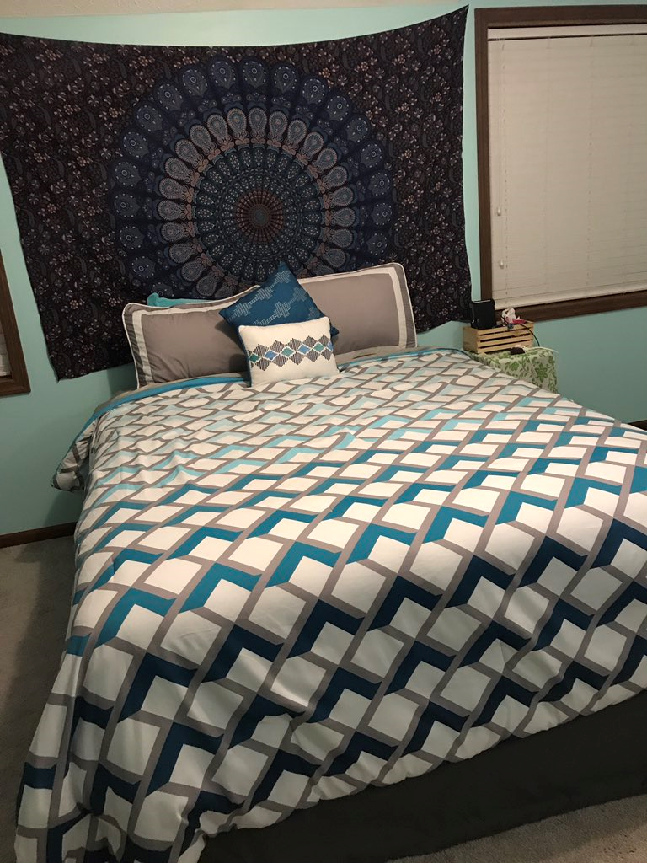
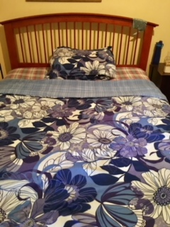
3 October 2017 SWBAT: analyze the use of literary and rhetorical devices in writing
Finding Common Ground
#makeyourbed beds
Bellwork (5 minutes)
Agenda (3 minutes)
Workshop
Stations
Peace/Out (2 minutes)

Slide 5
3 October 2017 SWBAT: analyze the use of literary and rhetorical devices in writing
Finding Common Ground
Stations
YN: paper, pen, textbook, novel, vocabulary
Before you go, I need to review each station
12-15 minute increments
Bellwork (5 minutes)
Agenda (3 minutes)
Workshop
Stations
Peace/Out (2 minutes)

Slide 6
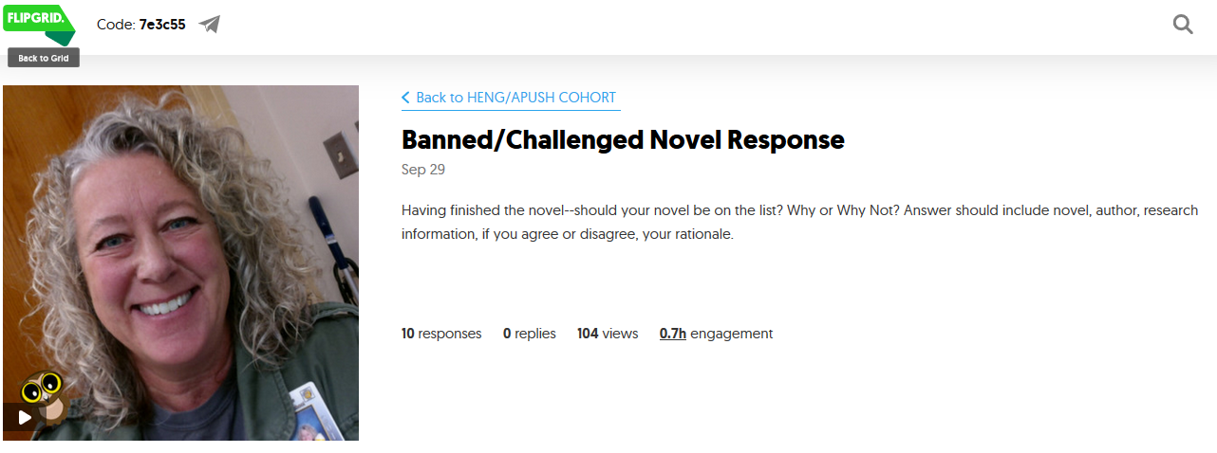
3 October 2017 SWBAT: analyze the use of literary and rhetorical devices in writing
Finding Common Ground
YN: your novel, pen, paper, phone?
Respond to prompt
Flipgrid
In writing
Station 1
Bellwork (5 minutes)
Agenda (3 minutes)
Workshop
Stations
Peace/Out (2 minutes)

Slide 7
3 October 2017 SWBAT: analyze the use of literary and rhetorical devices in writing
Finding Common Ground
YN: brain, puzzle pieces
Bring disparate pieces together to form one unified puzzle.
Station 2
Bellwork (5 minutes)
Agenda (3 minutes)
Workshop
Stations
Peace/Out (2 minutes)

Slide 8
3 October 2017 SWBAT: analyze the use of literary and rhetorical devices in writing
Finding Common Ground
YN: your novel, pen, paper
Complete a plot diagram over your novel
1. Please pay specific attention to the language
“exposition”
“theme”
Station 3
Bellwork (5 minutes)
Agenda (3 minutes)
Workshop
Stations
Peace/Out (2 minutes)

Slide 9
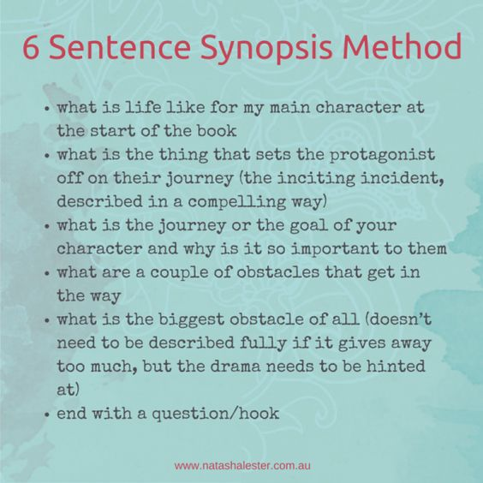
3 October 2017 SWBAT: analyze the use of literary and rhetorical devices in writing
Finding Common Ground
Station 4
YN: novel, paper, pen
Create a 6 Sentence Synopsis of your novel
Bellwork (5 minutes)
Agenda (3 minutes)
Workshop
Stations
Peace/Out (2 minutes)

Slide 10
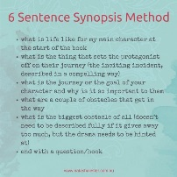
3 October 2017 SWBAT: analyze the use of literary and rhetorical devices in writing
FINDING COMMON GROUND
1. One rainy day, two bored kids.
2. a figure appears, and he is loaded with fun ideas.
3. the kids have to choose between their desire for fun
4. and the lessons they have learned.
5. There’s only a short window of time before their parents get back and see the destruction
6. Will good win out in the end?
Bellwork (5 minutes)
Agenda (3 minutes)
Workshop
Stations
Peace/Out (2 minutes)

Slide 11
3 October 2017 SWBAT: analyze the use of literary and rhetorical devices in writing
Finding Common Ground
YN: vocabulary cards, pen, paper
Create a story, pass it on
Tell me a story using the vocabulary
Know that someone else is coming in to twist it.
Highlight the words so I can see them.
Sign your name so I can give credit
Station 5
Raconteur Revelry
Bellwork (5 minutes)
Agenda (3 minutes)
Workshop
Stations
Peace/Out (2 minutes)

Slide 12
3 October 2017 SWBAT: analyze the use of literary and rhetorical devices in writing
Finding Common Ground
YN: annotated article
Identify claim, support with evidence, identify method of persuasion
You already know:
Article name: “goes in quotes”
Author: (you did not create, so you need to source)
Site: where did it come from
Station 6
Prove It
Bellwork (5 minutes)
Agenda (3 minutes)
Workshop
Stations
Peace/Out (2 minutes)

Slide 13
3 October 2017 SWBAT: analyze the use of literary and rhetorical devices in writing
Finding Common Ground
YN: annotated article
Identify method of persuasion
Ethos (drop names for credibility)
Pathos (tell story to help connect)
Logos (facts and figures to establish logic)
Station 6
Bellwork (5 minutes)
Agenda (3 minutes)
Workshop
Stations
Peace/Out (2 minutes)
Prove It
Rhetorical devices

Slide 14
3 October 2017 SWBAT: analyze the use of literary and rhetorical devices in writing
Finding Common Ground
YN: textbook, stickynotes
Identify literary devices
Read paragraphs 6-8 together
(I would read one at a time)
2. Go back and identify any devices we have discussed on stickynote
3. Know that I will ask how this is effective—how it convinces you of her message (and I will ask what her message seems to be)
Station 7
Duly Noted
Bellwork (5 minutes)
Agenda (3 minutes)
Workshop
Stations
Peace/Out (2 minutes)

Slide 15
3 October 2017 SWBAT: analyze the use of literary and rhetorical devices in writing
Finding Common Ground
Textbook Work
“The Quilt of a Country”
Tell me ones you have already seen
Bellwork (5 minutes)
Agenda (3 minutes)
Workshop
Stations
Peace/Out (2 minutes)
Annotation Skills
Irony
Juxtaposition
Allusion
Rhetorical Questions
Repetition
You will eventually be answering:
How does Quindlan use the devices to emphasize her claim?

Slide 16
3 October 2017 SWBAT: analyze the use of literary and rhetorical devices in writing
Finding Common Ground
HOMEWORK
Bellwork (5 minutes)
Agenda (3 minutes)
Workshop
Stations
Peace/Out (2 minutes)
1. Study your vocabulary

Slide 17
3 October 2017 SWBAT: analyze the use of literary and rhetorical devices in writing
Finding Common Ground
Write on a piece of scratch paper
Name/Teacher/Block/Date
None
PLEASE USE MLA HEADING
Bellwork (5 minutes)
Agenda (3 minutes)
Workshop
Stations
Peace/Out (2 minutes)

