Slide 1
17 October 2017 SWBAT: practice multiple skills Learning Goals:
Finding Common Ground
Bellwork
Life Lessons
YN: utensil/paper
Notetaking
Bellwork (15 minutes)
McRaven Cornell Notes
Agenda (3 minutes)
Skill (40 minutes)
Stations discussion
Workshop (30)
Stations
Reflection
Vocabulary
DBQ knowledge
Peace/Out (2 minutes)
https://www.youtube.com/watch?v=pxBQLFLei70

Slide 2
17 October 2017 SWBAT analyze the use of literary devices in writing
UPCOMING- EVEN DAY
THIS WEEK 10/17 New Vocabulary Stations HW: finish all station work 10/19 MAPS Results Goal setting Vocab practice HW: finish reflection | NEXT WEEK 10/23 Timed Revision of DBQ Vocab practice HW: none 10/25 Peer edit of DBQ/Submit Vocab practice HW: none 10/26 NO SCHOOL Parent/Teacher Conferences 10/27 NO SCHOOL
Put this in your Agenda

Slide 3
17 October 2017 SWBAT: reflect on writing process
Finding Common Ground
HOMEWORK
Bellwork (15 minutes)
McRaven Cornell Notes
Agenda (3 minutes)
Skill (40 minutes)
Stations discussion
Workshop (30)
Stations
Reflection
Vocabulary
DBQ knowledge
Peace/Out (2 minutes)
1. Finish what was started in stations

Slide 4
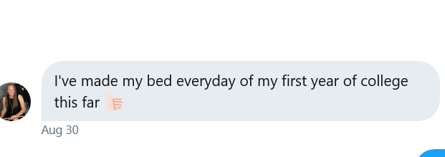
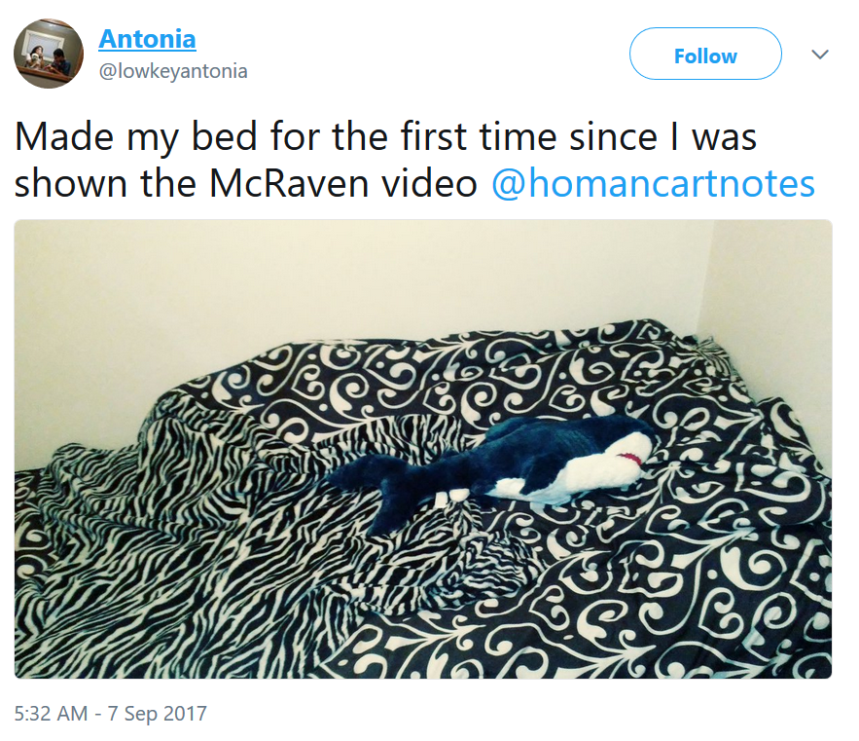
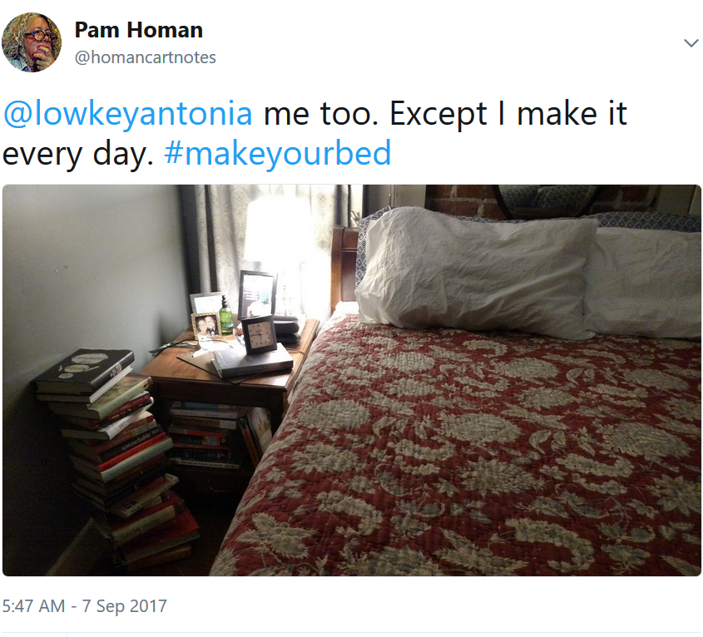
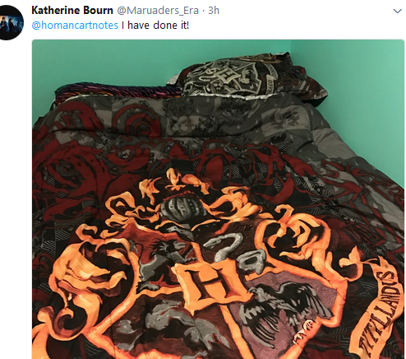
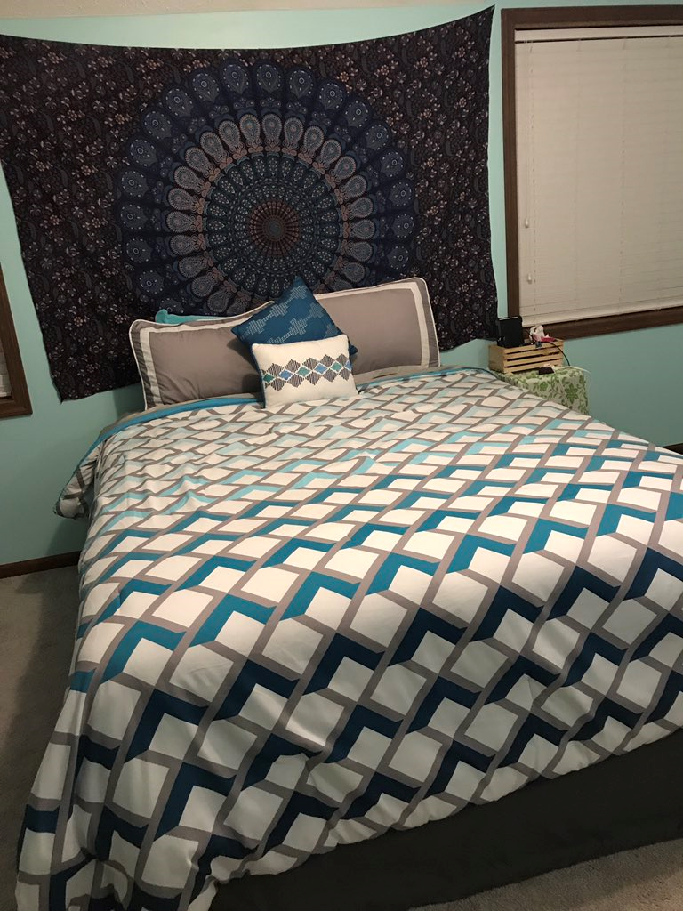
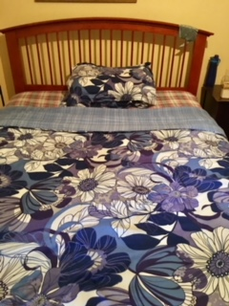
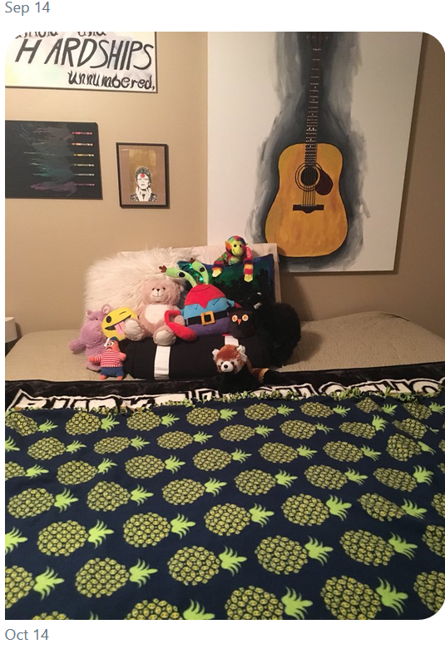
17 October 2017 SWBAT: reflect on writing process
Finding Common Ground
#makeyourbed beds
Bellwork (15 minutes)
McRaven Cornell Notes
Agenda (3 minutes)
Skill (40 minutes)
Stations discussion
Workshop (30)
Stations
Reflection
Vocabulary
DBQ knowledge
Peace/Out (2 minutes)

Slide 5
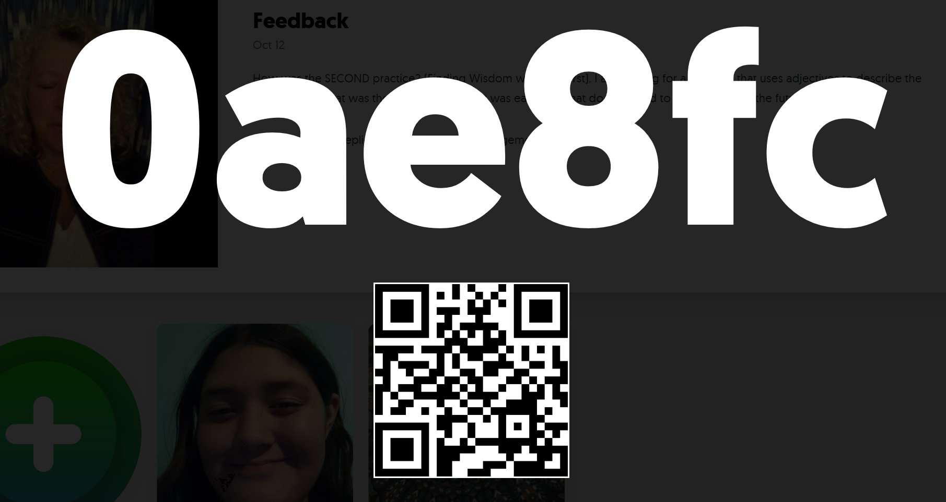
17 October 2017 SWBAT: reflect on writing process
Finding Common Ground
Students will: utilize multiple literacies
STATIONS
FLIPGRID or Written Response Listen to the prompt Answer using all skills developed thus far. Looking for SPECIFIC examples to support your claim. | Vocabulary Building Annotate document Create cards | DBQ Element Breakdown Annotate What is MY thesis What is YOUR thesis Annotate What is your evidence? Annotate Your “rationale”
Bellwork (15 minutes)
McRaven Cornell Notes
Agenda (3 minutes)
Skill (40 minutes)
Stations discussion
Workshop (30)
Stations
Reflection
Vocabulary
DBQ knowledge
Peace/Out (2 minutes)

Slide 6
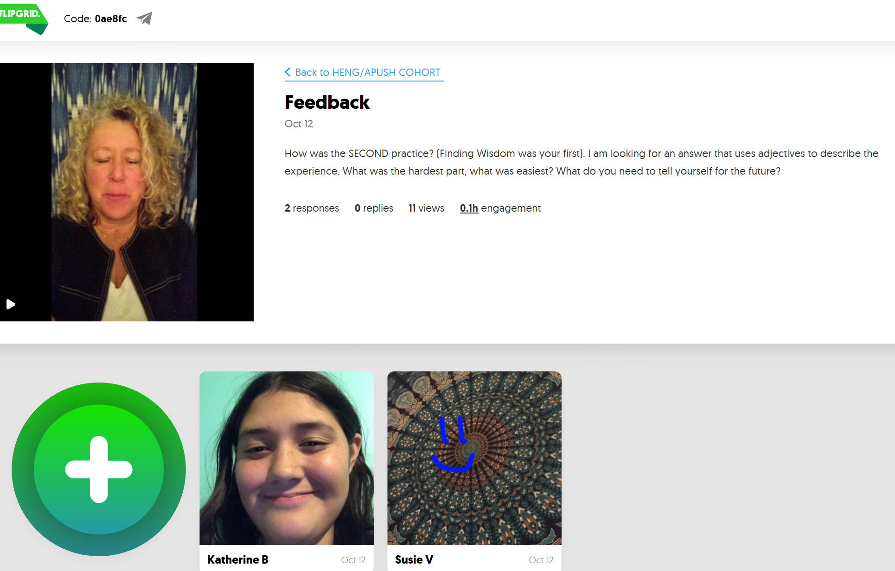
17 October 2017 SWBAT: reflect on writing process
Finding Common Ground
Students will: defend answer with opinion
Flipgrid
In writing
Respond to Prompt
Bellwork (15 minutes)
McRaven Cornell Notes
Agenda (3 minutes)
Skill (40 minutes)
Stations discussion
Workshop (30)
Stations
Reflection
Vocabulary
DBQ knowledge
Peace/Out (2 minutes)

Slide 7
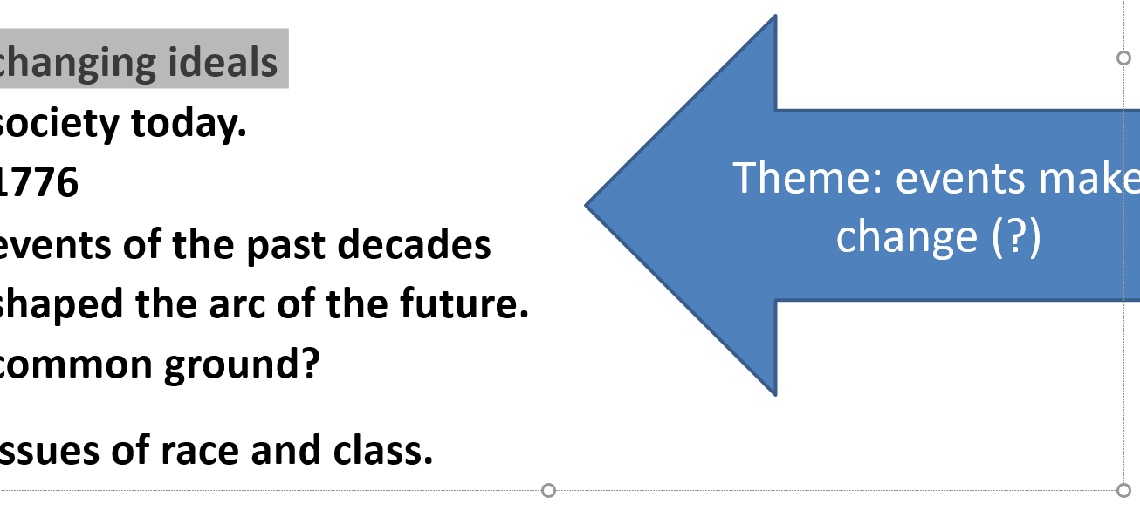
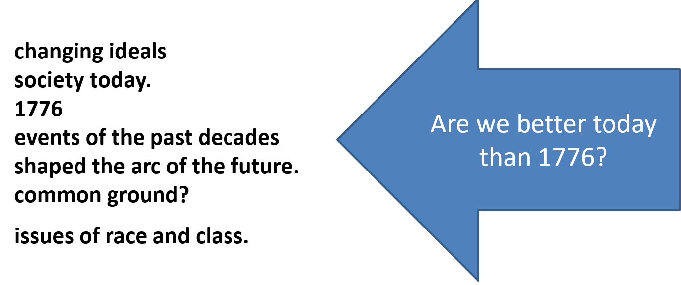
17 October 2017 SWBAT: reflect on writing process
Finding Common Ground
Students will: evaluate their writing
YN: highlighter/your paper/ project description/
my paper
Highlight key words in the question
Discuss the changing ideals of what it means to be an American in society today. Have the ideals of “health, wealth, and happiness” for all men as adopted on the eve of July 3, 1776 changed over time? Assess the extent to which events of the past decades have shaped the arc of the future. Have we found enough common ground? In your answer be sure to consider issues of race and class. Use the documents and your knowledge in constructing the response.
2. See if there is a “theme”
3. Ask yes/no question 4. Establish thesis
DBQ Breakdown
Bellwork (15 minutes)
McRaven Cornell Notes
Agenda (3 minutes)
Skill (40 minutes)
Stations discussion
Workshop (30)
Stations
Reflection
Vocabulary
DBQ knowledge
Peace/Out (2 minutes)

Slide 8
17 October 2017 SWBAT: reflect on writing process
Finding Common Ground
Students will: increase knowledge of words
YN: highlighter/lyrics/ notecards/
Annotate lyric sheet
Look up words using inference skills, then dictionary (or online dictionary)
Create cards for future use in class
Vocabulary Development
Bellwork (15 minutes)
McRaven Cornell Notes
Agenda (3 minutes)
Skill (40 minutes)
Stations discussion
Workshop (30)
Stations
Reflection
Vocabulary
DBQ knowledge
Peace/Out (2 minutes)

Slide 9
17 October 2017 SWBAT: reflect on writing process
Finding Common Ground
HOMEWORK
Bellwork (15 minutes)
McRaven Cornell Notes
Agenda (3 minutes)
Skill (40 minutes)
Stations discussion
Workshop (30)
Stations
Reflection
Vocabulary
DBQ knowledge
Peace/Out (2 minutes)
1. Finish the different stations

Slide 10
17 October 2017 SWBAT: reflect on writing process
Finding Common Ground
Write on a piece of scratch paper
Name/Teacher/Block/Date
What was the thesis you used for your writing?
PLEASE USE MLA HEADING
Bellwork (15 minutes)
McRaven Cornell Notes
Agenda (3 minutes)
Skill (40 minutes)
Stations discussion
Workshop (30)
Stations
Reflection
Vocabulary
DBQ knowledge
Peace/Out (2 minutes)

